Slide 1
SYSTEMS AND SUSTAINABILITY
Peter Harper
CAT

Slide 2
MY FUNDAMENTAL QUESTION
How can we avoid forcing everything into a linear, mechanistic framework?
And yet maintain due rigour and a common language?

Slide 3
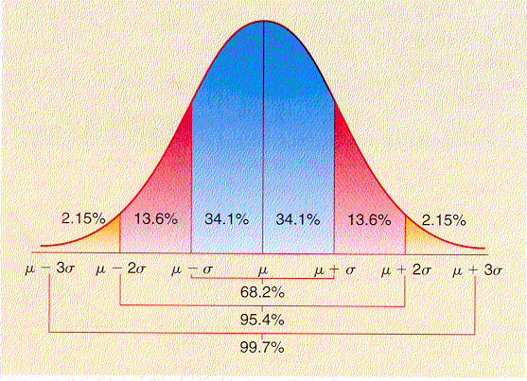
EMERGENCE
The normal curve (etc)
Drops of rain on a pavement square
How do they know the equations?
You cannot mimic this yourself
The only way to achieve this perfection is to get out of the way and let it happen
Randomness is ordered
Is this mysterious? Creepy? Inevitable? Simply ‘mechanistic’?

Slide 4
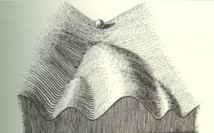
OTHER ‘SYSTEMIC’ INFLUENCES IN THE 60s
Homeostasis, basic negative feedback regulation
Cybernetics
General Systems Theory
Formal ecology, particularly Eugene and Howard Odum
stocks, flows, sinks etc
The Lotka-Volterra population equations, then hard to model without computers
C.H. Waddington’s approach to development, topological, prefigures ‘attractors’
Theoretical biology, Tools of Thought
He was also an art collector and critic
But refused to acknowledge the ‘Kuhnian revolution’
‘Distant battles’, e.g. Koestler and Medawar
The mathematics of discontinuity, ‘catastrophes’
‘Heuristics’ (Polya)
Tacit knowing

Slide 5
Tacit knowing
The plural of
Carrot
Potato
Lemon
Broccoli
Grape
Parsley
Basil
Celery
Mornington Crescent
Trafalgar Square
Baker Street
Edgeware Road
Goodge Street
Shepherd’s Bush
Old Street

Slide 6
THE ‘KUHNIAN REVOLUTION’
As students, we were given to understand that the process of science is lawful, settled, and essentially algorithmic
Kuhn’s The Structure of Scientific Revolutions successfully challenged the mainstream view
It is not algorithmic
As a result I experienced a period of intellectual anarchy, fanned by Paul Feyerabend
Compare ‘postmodernism’
As a prodigal son, I gradually worked back to appreciating the key principles of ?’critical realism’
Popper + ?common sense ?wisdom
Love your enemies
Definitely not algorithmic, but there is a sense of a shared, lawful world

Slide 7
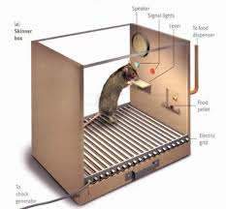
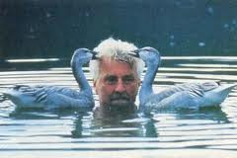
PERSONAL PROOF OF A ‘KUHNIAN’ PERSPECTIVE
Two departments with the same official goal
On the classic account of science they will discover exactly the same things and explain them in the same way
Quite the opposite was the case!
There was virtually no overlap, and no mutual knowledge or communication between the two
Ergo, science is human, political, personal, and to some extent is socially constructed
Blimey!

Slide 8
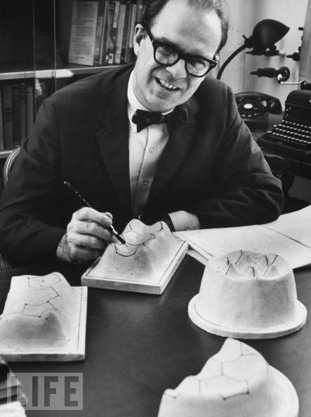
AN IMPORTANT CONCLUSION
The ‘reductionist heuristic’ is an essential tool in the box
My mentor John Platt called it ‘Strong Inference’
It has proved amazingly powerful, especially after a period of neglect
Anti-reductionist bias can obscure the drawing of ‘obvious’ conclusions
Example in bacterial transformation, a gap of 25 years till ‘problem solved’
Initiatives in biology switched decisively to biochemistry and biophysics

Slide 9
Natural selection, a key notion…is an extremely simple algorithm, almost as fundamental as thermodynamics: surely, it cannot but be so
Rigorous ‘strong inference’ is not incompatible with systems thinking
AND…
You have to do the numbers!!

Slide 10
MEANWHILE…3 PARALLEL TRACKS
SCIENTIFIC TRAINING
ENVIRONMENTAL AWARENESS
METAPHYSICS

Slide 11
‘METAPHYSICAL’ INFLUENCES Not strictly ‘systems’, but anti-reductionist
My father, an eccentric autodidact
Theosophy
The Perennial Philosophy and esotericism
‘The world behind appearance’
Is science intrinsically blind to this?
Can spiritual practices tell us useful things we cannot know in any other way?
Can it uniquely do useful things?
Can there be a meeting-ground between science and ….er…whatever it is?
David Bohm, Fritjof Capra

Slide 12
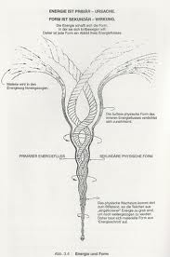
TO CONTINUE THE METAPHYSICAL THREAD A BIT…
Occult anatomy/physiology
Acupuncture
The chakra system
Chi/prana/élan vitale
Biographical accounts
Gurdjieff
Baba Ram Das
Rupert Sheldrake, an unashamed vitalist:
morphic resonance
Hidden attractors
Earth energies, leylines, lost knowledge, ancient technologies
“A certain arcane cause more excellent than reason”
Goethe and Steiner
Magical thinking: an enemy of sustainability?
Radical idealism: the physical universe is itself a construct
The memory of water, homeopathy, Jacques Benveniste
The Scientific and Medical Network
Rigorously controlled trials in US labs
Precognition, telepathy

Slide 13
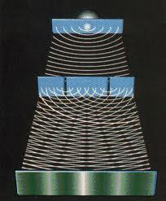
WHAT CAN WE SAY ABOUT THE LEGACY OF “APPLIED METAPHYSICS”?
Quantum theory, and increasingly, practice, expands the boundaries of what is thinkable in physics. Seriously weird, and getting weirder.
Modelling (even if not entirely algorithmic) has solved many ‘mysteries’
Emergent properties have been particularly surprising, moving the ‘mysteries’ further back in time
The Anthropic Principle, tuning the universe
We do appear to be ‘in the middle’
Some very rugged results, but hard to apply them
Some apostasies, notably Susan Blackmore
Controlled trials usually turn up blank: I have carried out many!
Deep ecology, Naess, Goldsmith…not going anywhere?
Links with sustainability, Laszlo, Skolimowski
A sense of retreat to minor niches
Do we have a richer and less rigid set of heuristics that we can deploy comfortably and skilfully? Possibly
I remain open-minded, but a reluctant ‘physicalist’

Slide 14
EMERGENCE II Wonders (or surprises) from ‘nothing’
Fuzzy logic
Dissipative systems (Heraclitus, Schroedinger, Prigogine)
Phase changes: abrupt Transitions
The power law f(x)=ax^{k} and other principles applying to a wide variety of loosely-connected systems
Scale invariance: Fractals and the Mandelbrot set
Chaos, complexity theory, ‘Strange’ attractors
Intrinsic discontinuities and collapses
The eukaryotic revolution, endosymbiosis, autopoesis
Origin of Life studies move towards ‘you can hardly stop it’
Gaia, Daisyworld
Note Dawkins’ misapplication of the reductionist approach
Note also Lovelock’s predictions about Mars!
Don’t forget natural selection itself
The Law of Requisite Variety

Slide 15
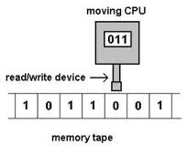
Communication Theory = Information Theory
“Entropy”
Maps onto thermodynamics
Information revealed as a fundamental feature of ….everything
The binary digit is the ‘atom’ of information
Digitisation makes everything algorithmic
The universal Turing machine
‘Information age’ sweeps in
Is it reductionistic, or the opposite?

Slide 16
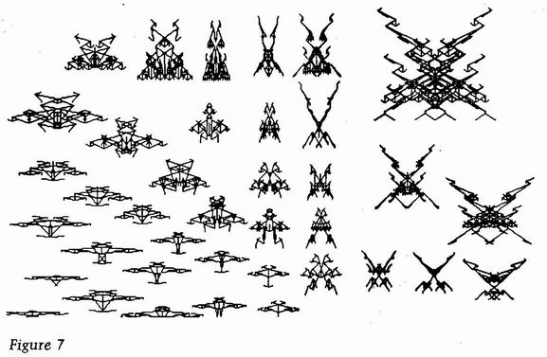
“ARTIFICIAL LIFE”
“A.I.” was the early buzzword
But proved surprisingly resistant
Accelerating again now
A.L. on the other hand…
The Game of Life
The genetic algorithm
Dawkins’ computer creatures
No need for mutations
Creatures become machine-like, but machines more creature-like
Life emerging from non-life: a key metaphor
It cuts both ways…

Slide 17
ENVIRONMENTAL THREAD
World hunger
Is not static, and is part of a complex system:
Population and positive feedback/exponential growth at the age of 16….
‘The environment’ and groping for notions of sustainability; ‘Futurology’
The Tragedy of the Commons
John Platt
Malign collective action, Arrow, Olson, Rappaport
The Prisoner’s dilemma, game theory
‘Bounded rationality’
Steady-state economics

Slide 18
WORLD 3 AND THE LIMITS TO GROWTH MODEL
It is algorithmic
But it produces surprises and discontinuities
Largely as a result of feedbacks and delays
Stability is not easily achieved without constant tuning
First attempts were suggestive but not fully convincing
Interesting that the strong mass-balance principle was easily avoided by the economists and others
Later versions are better
Demonstration that hierarchical organisation is more efficient, with a series of ‘levels’ (‘holons’)

Slide 19
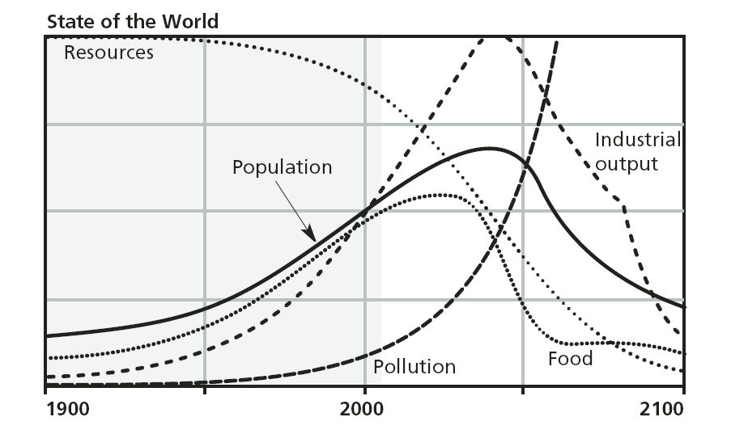
REPRESENTATIVE ‘WORLD 3’ RUN

Slide 20
LATER SYSTEMIC APPROACHES
‘Narratives’ ‘Frames’ ‘Discourses’
Relativism, postmodernism
Bollocks to all this: the problem is obvious
The Canute Principle
Can we co-ordinate across disciplines?
Is there a lingua franca?
Is design a key idea?
Are there universal design principles?
Probably not!

Slide 21
MORE
Rawlsian approaches to equity across time
Stocks and flows models, mass balance
IPAT and the Kaya Identity
Carbon becomes the key term for Limits to Growth
Howard Odum and Emergy analysis
The return of steady-state economics
Argument revolves around whether you can, or can’t, get a quart out of a pint pot

Slide 22
LATER COLLAPSE MODELS
Jared Diamond’s examples
Tainter’s slightly contrasting view
Neither mentioned in Fukuyama or ‘scholarly’ treatments
David Holmgren’s 4 scenarios
From linear to strong positive feedback elements in the climate system
It is getting difficult to see how major discontinuities can be avoided. Where are the places in the system where it can be influenced? And why do we think benign influences will prevail?
What are the ethics if collapses appear unavoidable? A new set of guidelines is required.

Slide 23
ORTHODOX MODEL
ECONOMIC GROWTH
ENVIRONMENTAL IMPACT

Slide 24
OVERSHOOT AND COLLAPSE
ECONOMIC GROWTH
ENVIRONMENTAL IMPACT

Slide 25
DEEP ECOLOGY?
ECONOMIC GROWTH
ENVIRONMENTAL IMPACT

Slide 26
MANAGED TRANSITION
ECONOMIC GROWTH
ENVIRONMENTAL IMPACT

Slide 27
MANAGED TRANSITION Zero-Carbon Britain approach
DECARBONISED INPUTS
EFFICIENCY
ECONOMIC GROWTH
ENVIRONMENTAL IMPACT

Slide 28
AN EXAMPLE OF CROSS-DISCIPLINARY SCENARIO-BUILDING ON THE CANUTE PRINCIPLE

Slide 29
2011
2030:
Many possible decarbonisation scenarios
2030 IS IN THE FUTURE
We explore about 20 key dimensions for decarbonisation scenarios, and discard 99%

Slide 30
2030:
Many possible decarbonisation scenarios
We pick this one, or you could say, we create it

Slide 31
2030:
Many possible decarbonisation scenarios
We explore it, challenge it, make sure it works, modify it, tell people about it, write novels about it, invite opponents to tea, get comfortable with it, visit the neighbours regularly, make everybody want to go there

Slide 32
2011-2030:
Remain aware there are many possible decarbonisation trajectories

Slide 33
THEN WE WORK BACK FROM 2030 AND FILL IN TABLES LIKE THIS
 | 2012 | 2015 | 2020 | 2025 | 2030 | 2050
International agreements | Provisional Kyoto 2 | Full Kyoto 2 | Phased implementation of C&C | Harmonised caps
Research | 2nd generation biomass | Energy storage technologies | The nitrogen problem | New food techno-logies
Infrastructure | Strengthen national grids | Euro super-grid | Re-modelled gas grid | Integrated Super-grids
Other technical develop- ments | Variability technologies | Offshore wind Hybrid hydrogen | Other Marine RE | CSP
Legal and financial instruments | Planning regulations | Various environ-mental taxes | Full carbon tax | Import regulations
Etc: lots more categories

Slide 34
Then you can say, of the many possible decarbonisation trajectories
We pick this one

Slide 35
THEN YOU CONVERT TO GANTT-TYPE CHARTS TO LOOK AT THE SEQUENCES AND TIMING OF DIFFERENT PROCESSES – LIKE THE I.MECH.E SCENARIO
2011
2030

Slide 36
THEN
You have a strategy
Where 2015 joins up with 2012, you have a handle for a campaign
And you can show how it might unfold, all the way to your 2030 goal, which everyone wants

Slide 37
ENOUGH ALREADY!

