Slide 1
“RESEARCH”? THINKING SIDEWAYS AT CAT

Slide 2
WHY SHOULD WE DO THINGS DIFFERENTLY?
It does not make sense for a small, unfunded institution to pretend it is like ‘real’ research institutions
It ought to play to its strengths
Lack of pressure to ‘publish’
Lack of pressure to choose solvable problems
Natural interdisciplinarity
“Big picture” “bitmap” approach
Willingness to engage with ‘wicked’ problems

Slide 3
THE FUZZY AND THE PRECISE ARE COMPLEMENTARY
Many small blocks will eventually build up to a big picture
A fuzzy big picture will tell you which blocks to work on first

Slide 4
BIG ERROR BARS ARE BETTER THAN FALSE PRECISION Don’t underestimate the value of the back of an envelope
A
C

Slide 5
ARE WE TALKING ABOUT A ‘NEW PARADIGM’?
In pure science, we mean a change in a really fundamental principle or ‘metaphor’
The earth goes round the sun
no need to know exactly how it works
Large plates move around the earth
no need to know exactly how it works
Result is a sudden flush of explanations
Biogeography, distribution of earthquakes and volcanoes
Previous paradigm often revealed as preserved by fudges
Also many suggestions for new research

Slide 6
NEW PARADIGMS IN APPLIED SCIENCE
…do not call into question the fundamental science
On the contrary, they insist on it!
But push in new directions suggested by the problem to be solved
New avenues for research, and new technologies
Again the ‘old paradigm’ is often revealed to be maintained by fudges

Slide 7
EXAMPLE: Rapid decarbonisation programmes
Required by the climate science
VERY IMPORTANT
But ignored as ‘unrealistic’
Involve a whole collection of ‘wicked problems’
The research community hates wicked problems
So do we! But we accept they must be tackled
We often use visual metaphors to explore the structure of the problems

Slide 8
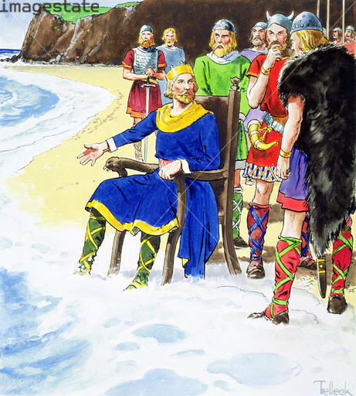
THE CANUTE PRINCIPLE “Triple bottom line” is misleading
Well guys, it looks as if we have a result
Physics Trumps Politics
Credit: © Stapleton Historical Collection / Heritage-Images / Imagestate

Slide 9
THE GAP BETWEEN POLITICAL REALITY (and economic, social, psychological) AND PHYSICAL REALITY
FURIOUS ACTIVITY
ZCB
POLITICAL REALISM
PHYSICAL REALISM
THE YAWNING CHASM

Slide 10
B
Physically feasible decarbonised worlds
You are here
A

Slide 11
The branch-point metaphor
‘ADAPTATION’ FUTURE
3-6° Temperature + PEAK OIL
Sequential hard landings for most of humanity?
Possible mass extinction
‘MITIGATION’ FUTURE
Preventing uncontrolled climate change
‘Soft landing’ for humanity
Biodiversity largely intact

Slide 12
OUR ‘NEW PARADIGM’ EMERGES FROM A SIMPLE FACT THAT EVERYONE KNOWS, BUT CANNOT ACT ON
That physics trumps politics
We can therefore rule out huge realms of potential futures that are impossible
And concentrate on the subset of the possible
The advantage of asking big questions is that it can tell you were to start looking for the small ones

Slide 13
THE BACK OF THE ENVELOPE
2011
2030:
Many possible decarbonisation scenarios

Slide 14
2030:
Many possible decarbonisation scenarios
We pick this one, or you could say, we create it
Why this one?
That itself raises a galaxy of interdisciplinary questions
Standard academic or political response: Too difficult! Don’t go there!

Slide 15
2030:
Many possible decarbonisation scenarios
We explore it, challenge it, make sure it works, tell people about it, write novels about it, invite opponents to tea, get comfortable with it, visit the neighbours regularly, make everybody want to go there

Slide 16
2011-2030:
Remain aware there are many possible decarbonisation trajectories

Slide 17
THEN WE WORK BACK FROM 2030 AND FILL IN TABLES LIKE THIS
 | 2012 | 2015 | 2020 | 2025 | 2030 | 2050
International agreements | Provisional Kyoto 2 | Full Kyoto 2 | Phased implementation of C&C | Harmonised caps
Research | 2nd generation biomass | Energy storage technologies | The nitrogen problem | New food techno-logies
Infrastructure | Strengthen national grids | Euro super-grid | Re-modelled gas grid | Integrated Super-grids
Other technical developments | Variability technologies | Offshore wind Hybrid hydrogen | Other Marine RE | CSP
Legal and financial instruments | Planning regulations | Various environ-mental taxes | Full carbon tax | Import regulations
Etc: lots more categories

Slide 18
Then you can say, of the many possible decarbonisation trajectories
We pick this one

Slide 19
THEN YOU CONVERT TO GANTT-TYPE CHARTS TO LOOK AT THE SEQUENCES AND TIMING OF DIFFERENT PROCESSES – LIKE THE I.MECH.E SCENARIO
2011
2030

Slide 20
THEN
Where 2015 joins up with 2012, you have the means for designing strategic transitions
And you can show how it might unfold, all the way to your 2030 goal, which everyone wants
This becomes the basis for a parallel narrative, or ‘Plan C’
It is a kind of ‘Apollo Project’ but that’s obvious

Slide 22
WHAT WOULD BE THE EFFECT OF DECARBONISING THE ENERGY SYSTEM? Note some small, some large effects

Slide 23
WHAT WOULD BE THE EFFECT OF 50% ‘CULTURED MEAT’? Evens things up a bit, suggests a preferred transitional path

Slide 24
Even at a back-of-the-envelope standard, this information is better than none at all, and potentially useful for policy, or to provoke properly-funded research.

Slide 25
But we must acknowledge that things are not looking too good for rational decarbonisation strategies! THE END
‘ADAPTATION’ FUTURES
3-6° Temperature + PEAK OIL
Sequential hard landings for most of humanity?
Possible mass extinction
‘MITIGATION’ FUTURES
Preventing uncontrolled climate change
‘Soft landing’ for humanity
Biodiversity largely intact

