Slide 1
LOW-CARBON FOOD AND DIETS
PETER HARPER

Slide 2
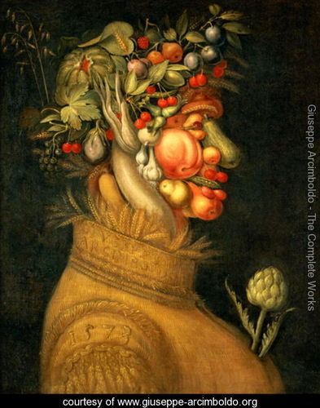
WHAT I AM GOING TO TALK ABOUT
Why low-carbon foods might be a good idea
What are low-carbon foods, (and diets)?
Why doesn’t everyone eat them?
Rude comments expected
What can be done to improve things (a bit)?
Suggestions gratefully received

Slide 3
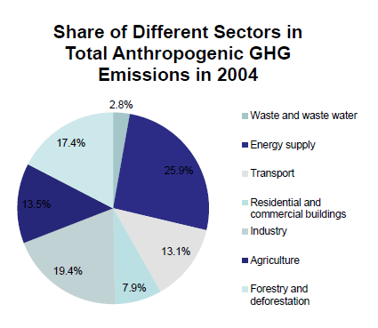
WORLD EMISSIONS
One third is not energy
Forestry and deforestation bigger than agriculture
But 58% deforestationcaused by agriculture (FAO)

Slide 4
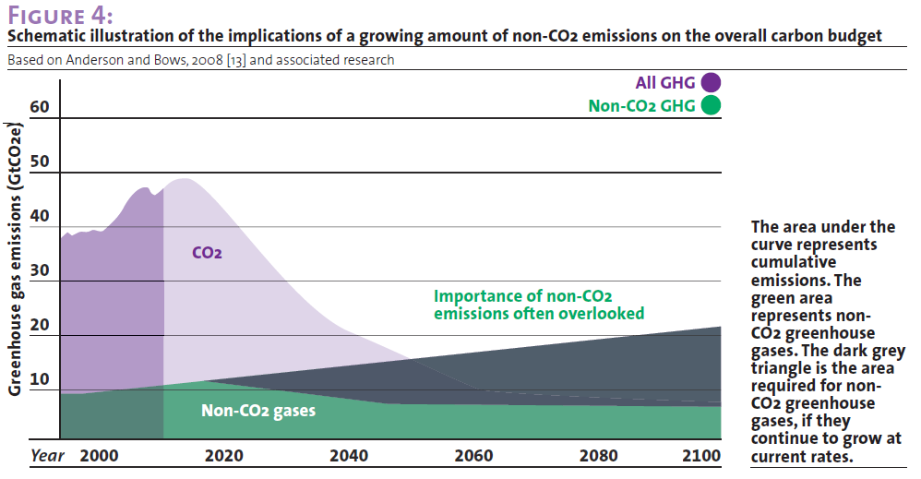

Slide 5
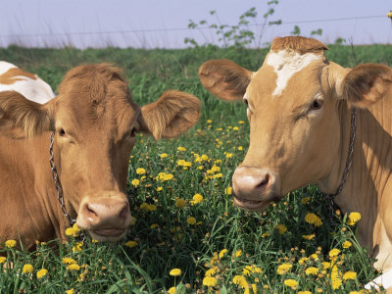
THE COW IN THE ROOM
ABOUT 45% OF EMISSIONS ARE AFTER THE FARM GATE, PROCESSING, TRANSPORT, COOKING ETC

Slide 6
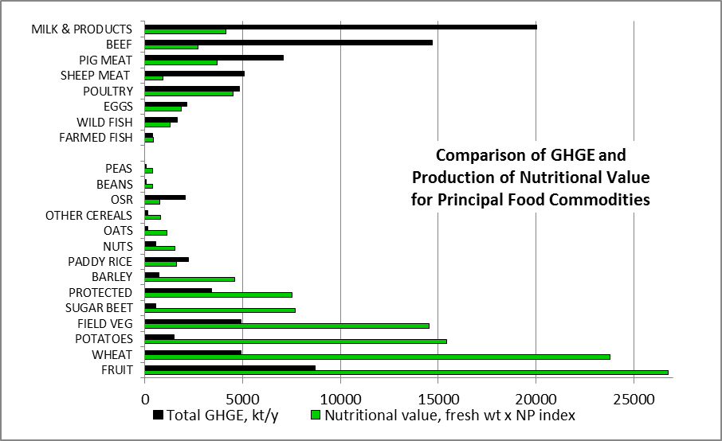
FOOD COMMODITIES AND THEIR EMISSIONS

Slide 7
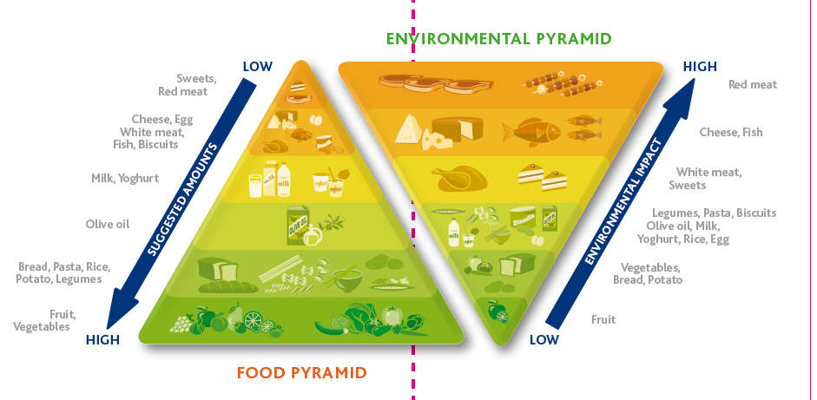
COMPARISON OF OPTIMUM DIETARY PROPORTIONS AND ENVIRONMENTAL INTENSITY http://www.barillacfn.com/images/download/positionpaper_barillacfn_double-pyramid.pdf

Slide 8
EXPLORATIONS OF LOW-CARBON DIETS

Slide 9
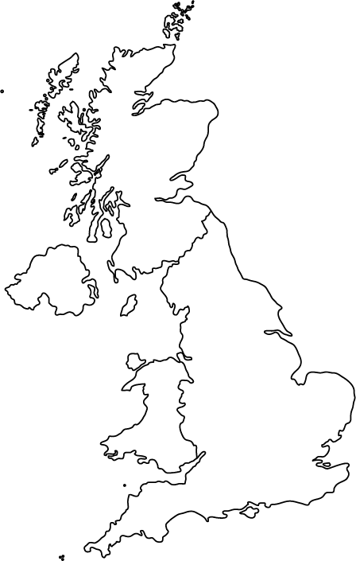
‘OTHER’
ALCOHOL
FRUIT AND VEG
OILS
GRAINS
EGGS
DAIRY
WHITE MEAT
RED MEAT

Slide 10
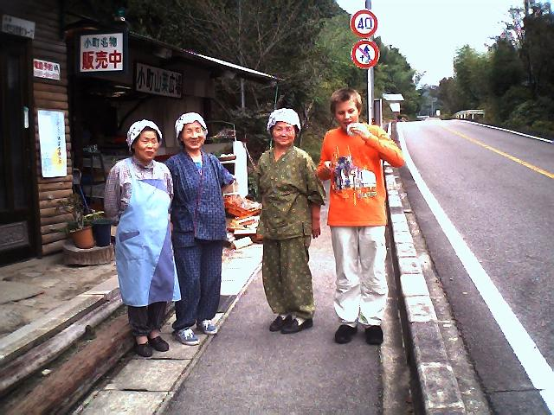
HOW DID WE GET HERE?
Europe, middle ages: Oats, occasional beans, dairy
The lactase gene
Later, potatoes (and dairy if you can get it)
Orient: Rice, occasional fish, ferments and pickled vegetables
Not bad basic diets. People were small, but so what?
Improvements in productivity, trade, more variety available
Diets improve, and could have got better and better
But increasingly subject to “corruption”

Slide 11
CORRUPTION?
Evolutionary hungers
Aping our betters
Food addictions
Commercial forces

Slide 12
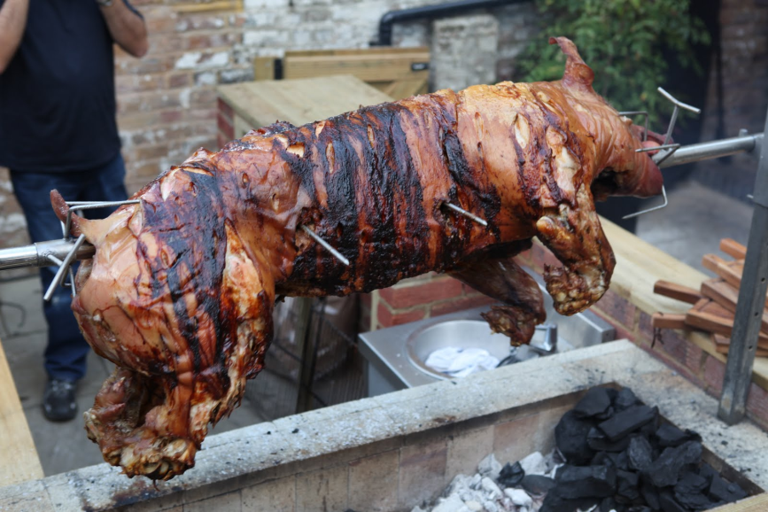
EVOLUTIONARY HUNGERS Why we like junk
Salt
Sugar
Or ready starch, comfort food
Fat
‘Umami’: savoury taste associated with protein
‘Caramelisation’ associated with frying and roasting
Driving force for
hunter-gatherers:
Go for these and you’ll get enough of what you really need
But this is not a good rule of thumb in modern societies!

Slide 13
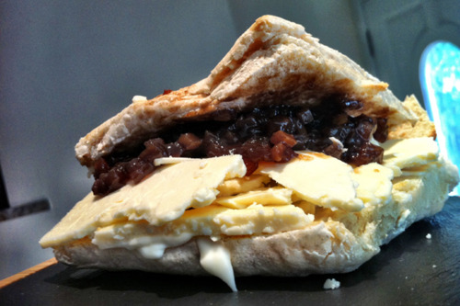
WHAT YOUR GUTS ARE USED TO
Europeans in Asia crave wheat, dairy
Asians in Europe crave rice!
Tastes and gut flora adapt and are very conservative
Cheap comfort-food
Fish, meat, dairy cravings
Remember Ben Gunn?
A lot of forces feeding the high-carbon diet on both sides of the farm gate
Wartime diet, basics plus orange juice, cod-liver oil, malt extract: improved health, but collapsed on the return of affluence

Slide 14
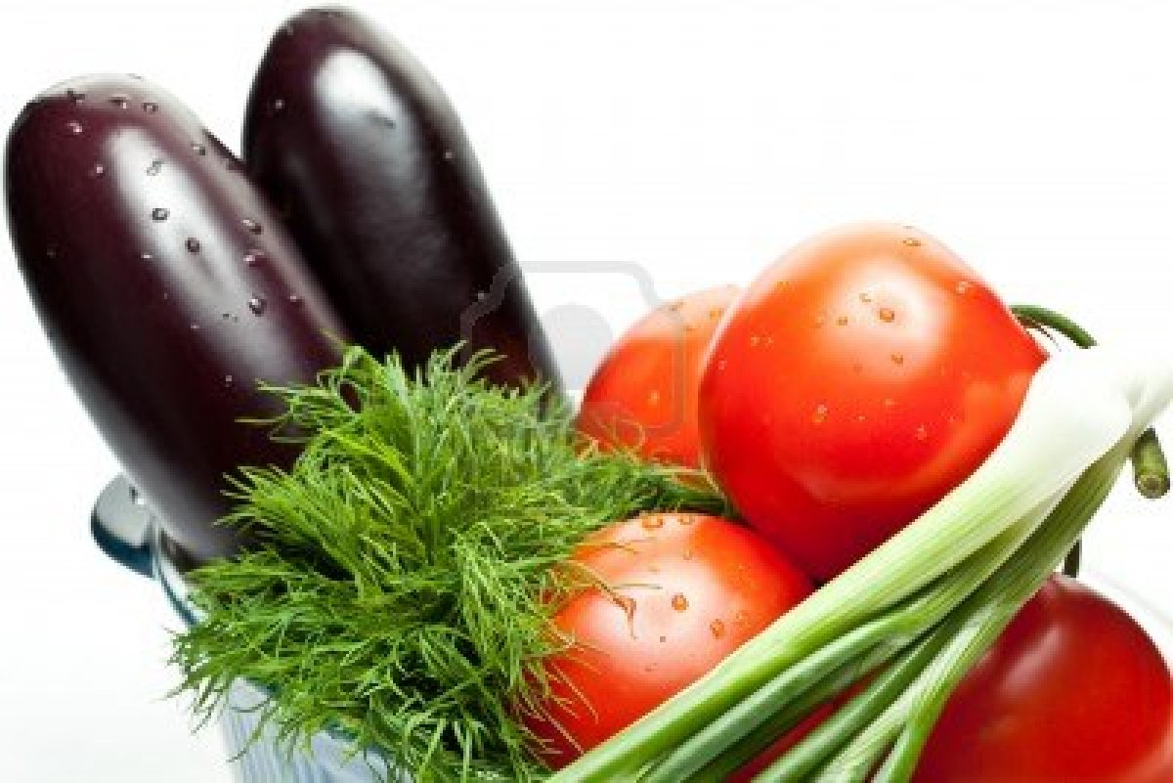
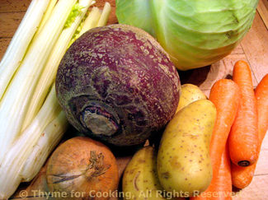
LOW CARBON DIETS What’s wrong with them?
‘Insubstantial’/stodgy/tasteless
Lack the rich protein hit
Do not feed addictions
Nice summer/out of season veg is not so ‘low’
But all those root crops are!!!
Take too long to cook
The ‘wind’ problem
Many people feel miserable with them, even get ill

Slide 15
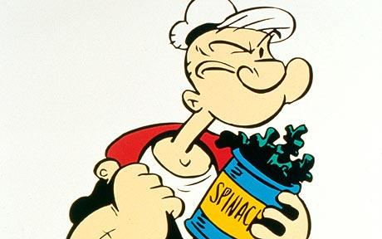
A GOOD RULE OF THUMB FOR THE BEST DIET FOR MOST PEOPLE? A personal summary of much complex evidence and opinion
Optimum dietary health can be achieved most easily by maximising the proportion and variety of fresh fruit and veg in the diet
This works the same way as the evolutionary hungers: You go for one thing and achieve another
You’re bound to get all the minor factors and calories (or you’d get hungry) and it would be hard not to get enough protein
The ‘protein problem’ is not really a problem

Slide 16
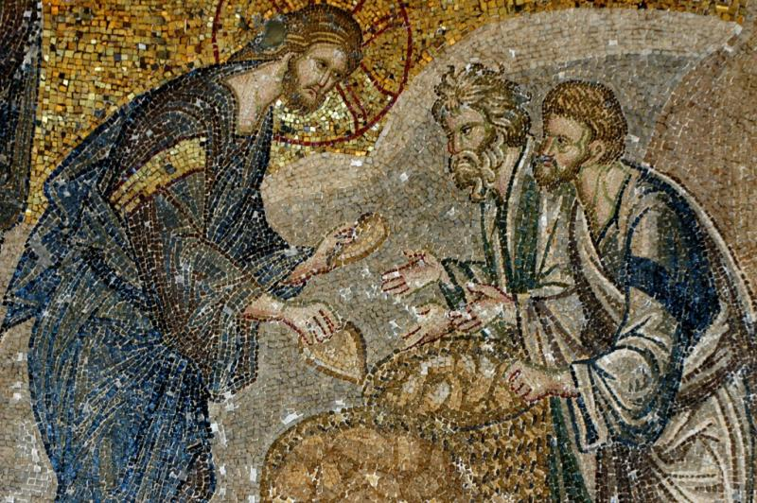
Think about these FAMOUS CULINARY COUPLES
Rice and dall
Noodles and tofu in fish stock
Fish and chips
Bread and cheese
Beans on toast
Spaghetti bolognese
Bangers and mash
Loaves and fishes

Slide 17
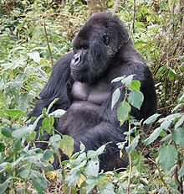
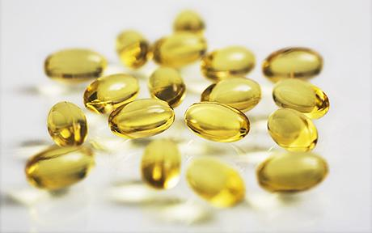
TRY THIS
Think fruit and veg all the time
Add as many different ‘culinary couples’ as you like
Aim for a wide variety across the day, week
Seasonal is good
Amplify livestock-based foods in the form of stock, flakes, relishes, sprinkles etc
‘Feastarian’ blow-outs are fine
Don’t be afraid of supplements, B12, fish capsules etc

Slide 18
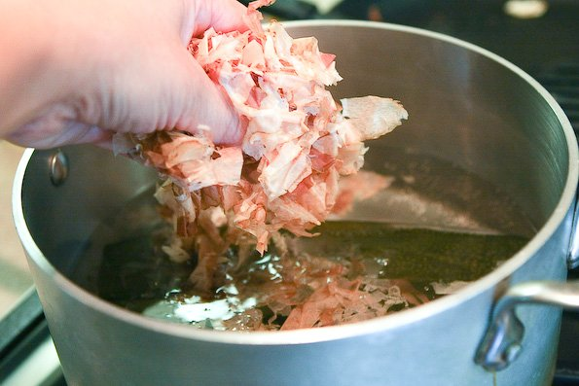
AVENUES FOR EXPLORATION Low-carbon alternatives
Experiment with veg proteins
Soya chunks?? Tofu, mycoprotein
Mushrooms, nuts, seeds
Umami relishes, kombu, ferments, miso,
Clever simulacra, eg ‘Tartex’ = pâté de fois
Stock, leftovers, bones, soup
Dripping, suet, offal, inventive new dishes
Sauces, garnishes, flakes, powders
Invertebrates, especially insects (we already do ‘seafood’, snails)
Artificial meat

Slide 19
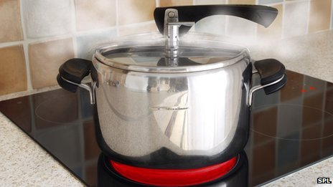
ROLL YOUR OWN
The basis of ‘low-C’ is still ‘the diet’
But how you get them, from where, and how they are prepared…also important, the other 45%
“Wholefoods” you prepare yourself are usually better, cutting out most of the post-farm-gate emissions
Dried goods are particularly good, soak ‘em
Sprouting, raw stuff, local, GYO

Slide 20
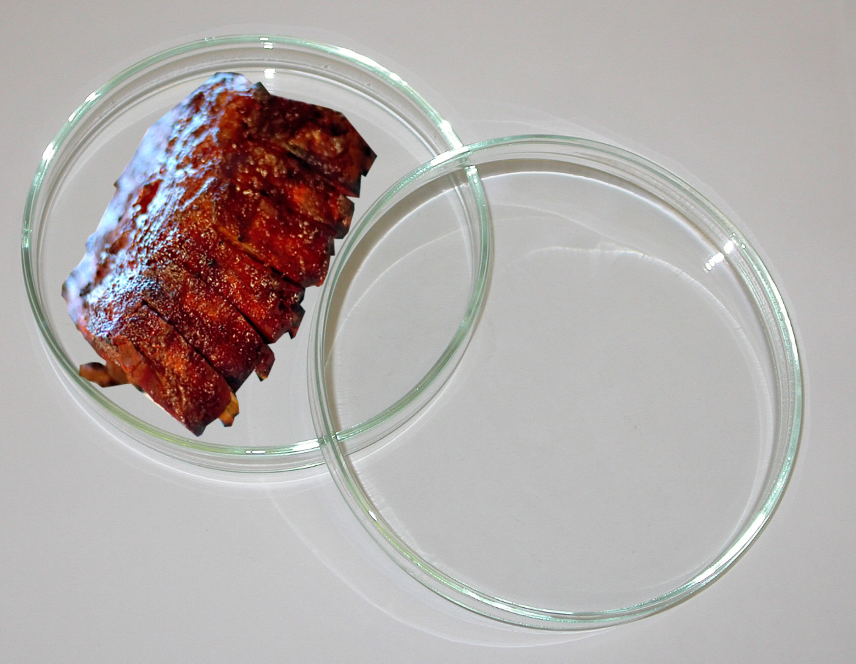
CULTURED MEAT
Biochemically similar to real meat
Low-carbon raw materials
So far not chewy or fatty enough
Early days, very expensive
Would start replacing ‘generic meat’ first
New cachet for the real thing?
Only organic left? Quantity to quality

Slide 21
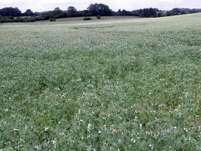
GIVE PEAS A CHANCE
They grow here in Britain
Colossal yields of protein per hectare
Fix their own nitrogen
Potentally many kinds
Great scope for breeding and development
Replace animal feeds too
Could be made into almost anything (else)

Slide 22
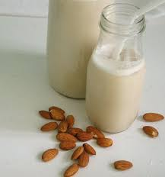
NEEDS WORK
The ‘milks’: nothing like milk
Extracting proteins from cheap sources
Transform sugars? Dirt cheap, low carbon
The Wind question, fixable?
Developing cultured meat
Organ printing?
What else?

Slide 23
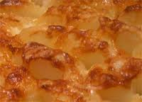
BACK TO…?
Oats and beans and a bit of dairy?
Well, grains and pulses…and potatoes
And as many salads and vegetables as you can possibly manage
Plenty of nice oils if you like them
With yummier garnishes, relishes, sauces etc
“Meat ’n ten veg”
And occasional mad blow-outs….

Slide 24
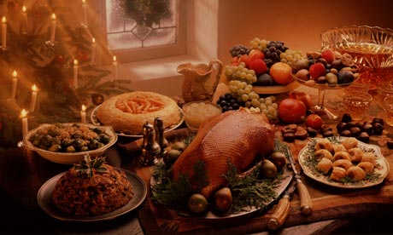
MERRY CHRISTMAS!
www.zerocarbonbritain.com
www.cat.org.uk

Slide 25
FOOD ADDICTIONS
Fatty foods
Salt, need more and more
Sugar
Blood sugar cycles
What doesn’t feed the addiction, yuck

Slide 26
COMFORT FOOD
Tasty, slips down
Instant gratification
Ready to eat, does not need much prep
Snacks
= baby food, little roughage
Can slowly get addicted

Slide 27
WHAT DO WE REALLY WANT?
Cheap
Tasty
Convenient
Healthy
Guaranteed supply
Appearance of countryside
National self-sufficiency
GM-free
Does not affect world supply
Organic, effects on biodiversity
Low impact on climate
Low impact on climate
Does not affect world supply
National self-sufficiency
Organic, effects on biodiversity
Healthy
GM-free
Appearance of countryside
Guaranteed supply
Cheap
Tasty
Convenient

Slide 28
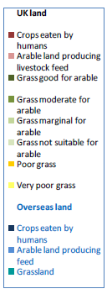
What else could we do?

Slide 29
AN ODD INVERSION
In hunter-gatherer times, follow the evolutionary hungers
These make sure you get enough of the right stuff
Today, this will make you ill
Try to eat as much as you can of the ‘good stuff’
These will make sure you get enough
“Meat ’n ten veg” is a good rule of thumb

Slide 30
‘FOOD REFORM’
Hang on – it does matter!
Quality as well as quantity
Organic movement, whole foods
Trying to set a new baseline – basic diet is really poor

Slide 31
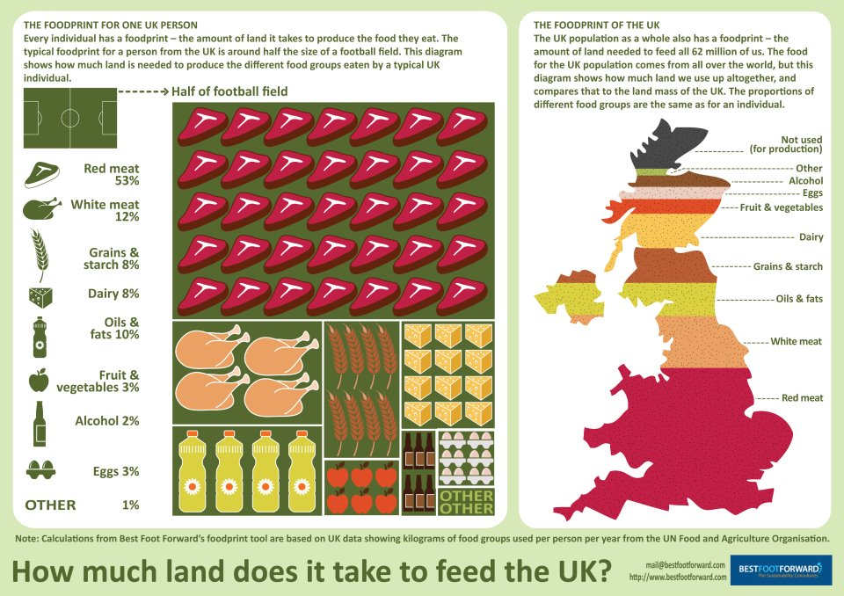
LAND REQUIREMENTS FOR UK FOOD From Best Foot Forward

Slide 32
