Slide 1
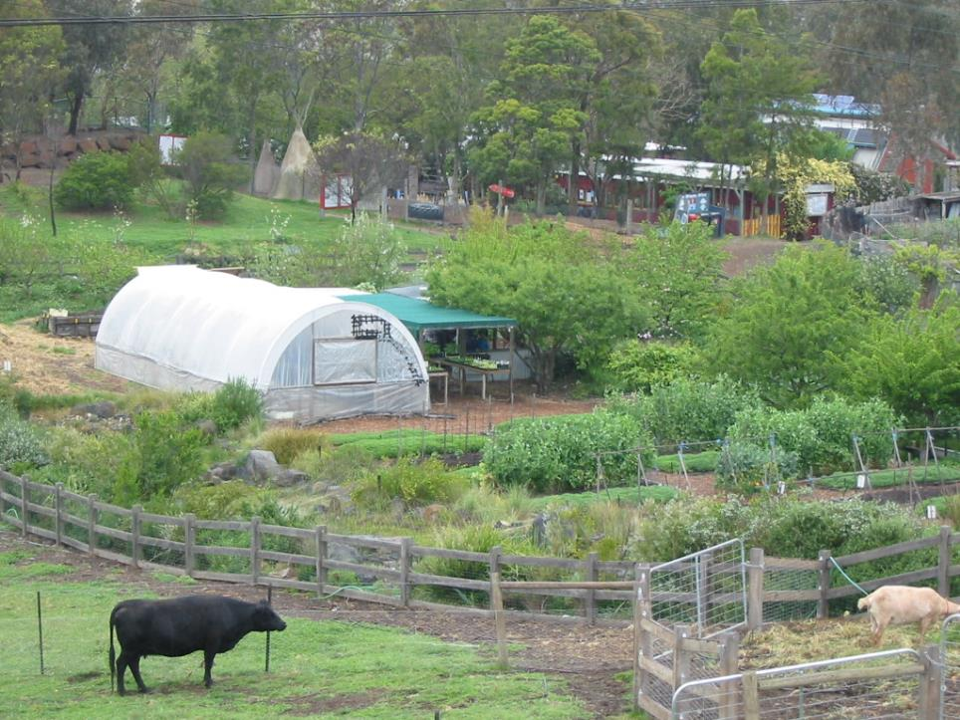
Sustainable Food and Natural Resources
Ecosystems Module
April 2018
FOOD
AND
FOOD SECURITY
Peter Harper

Slide 2
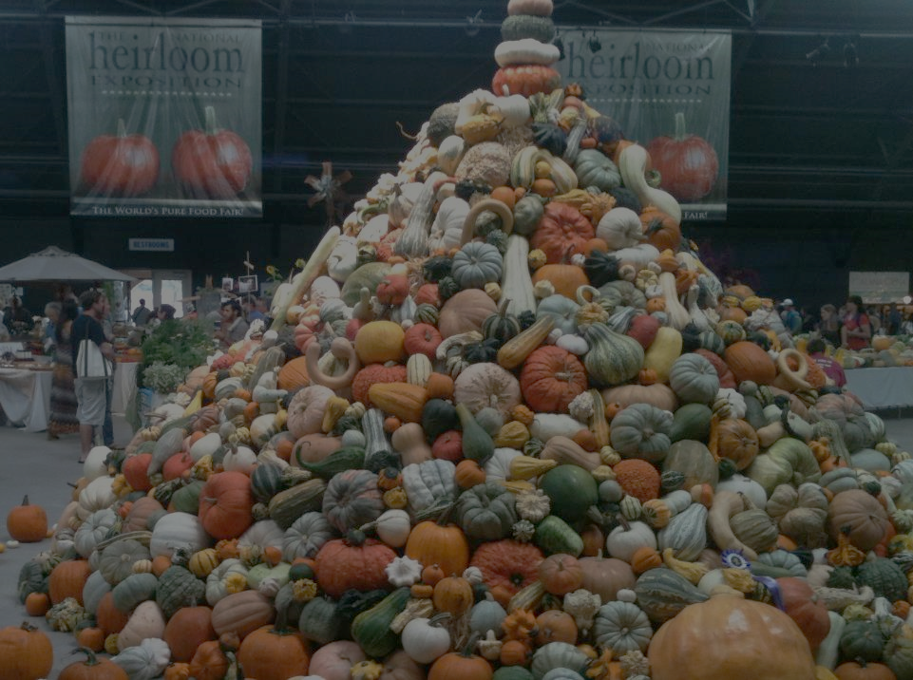
WHAT DOES ‘FOOD SECURITY’ REALLY MEAN?
Absolute sufficiency, or food quality
Mass insufficiency (famines) or inadequate supplies for smaller groups/individuals
World or UK

Slide 3
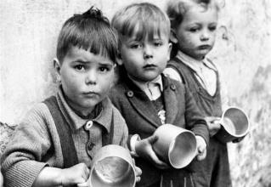
TWO ASPECTS OF ABSOLUTE SUPPLY
‘World’ food security, basically affecting developing countries
  With minor effects in Britain
Food security in the UK (or other developed countries): a completely different kind of problem
  But food choices and policies in the UK affect the world system
Feeding People is Easy (Tudge, 2007)
  “Plenty of plants, not much meat, maximum variety”
But on the whole, policy does not follow this simple formula, either in Britain or the wider world

Slide 4
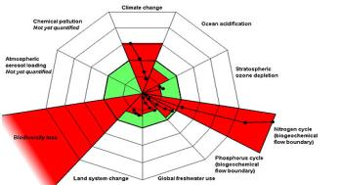
GLOBAL IMPACT OF HUMAN DEMAND FOR FOOD
Human-appropriated net primary productivity is about 25% of total photosynthesis
Many other effects on natural systems and ecosystem services
Trends partly driven by population growth
Changes of diet probably a stronger driver

Slide 5

SO: THE GREATEST LONG-TERM THREAT TO FOOD SECURITY COULD COME FROM THE FOOD SYSTEM ITSELF
Green sectors represent relative impact from agriculture, my provisional estimates. In nearly all cases the livestock sector is the largest component of the impact from agriculture

Slide 6
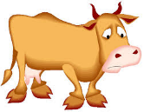
A CENTRAL HYPOTHESIS, SUPPORTED BY A GREAT DEAL OF EVIDENCE
DIETS AND THE AGRICULTURAL PRODUCT MIX are the most significant factors in long term global food security
The most significant change is
LOWER LEVELS OF LIVESTOCK PRODUCTS
  Note this has nothing to do with animal welfare
If we in the UK don’t follow this up, there will be increasing damage to ecosystem services on which the food supply depends
…and other people might actually starve…
Note that this is a ‘contested’ conclusion that is vigorously resisted, or simply ignored
You are yourselves invited to contest it, with appropriate data and calculations

Slide 7
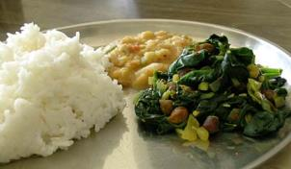

BASIC NUTRITIONAL NEEDS
EACH CATEGORY NECESSARY BUT NOT SUFFICIENT
Energy
  obtainable from carbohydrates, fats, proteins
  Anything that can be turned into ATP
  You need lots, especially if active
Structural materials
  mostly obtainable from proteins (plus some fats, minerals)
  Nitrogen- and phosphorus-containing molecules particularly significant
  Need declines in adulthood
  Hard not to get enough protein in a modern diet
Vitamins, minerals, fibre
  Found erratically mixed with other foods
  Only small quantities required
  They are necessary
  If pressed, you can get supplements cheaply out of bottles

Slide 8
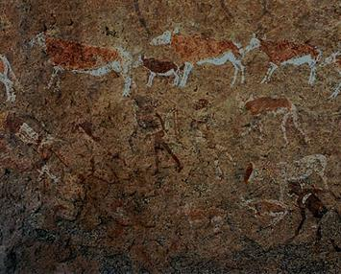
NATURAL DIET?
Hard to tell what is the ‘natural diet’ for human beings
Gut and dentition suggest ‘omnivory’
  But this means ‘eat anything’ rather than ‘eat everything’
There are examples of traditional cultures that are completely carnivorous, and others completely herbivorous
  So all combinations are physiologically possible
  But any diet must have all the basics
Use of fire opened greater food options
  As a hunting tool
  As a habitat management tool, mostly to remove trees
  Cooking: might have affected our physical evolution

Slide 9
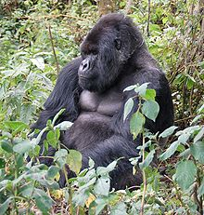
COMPARE GORILLA DIET
(Mountain gorilla Gorilla beringei beringei)
Human equivalent of about 9kg a day
  As opposed to 0.5-1.5kg
86% leaves, shoots and stems
  Most of which is indigestible
7% roots, 5% flowers and fruit, 2% invertebrates
We prefer to use ‘concentrates’
And increase availability of nutrients by cooking
Groves, C. (2005). Wilson, D. E.; Reeder, D. M. eds.Mammal Species of the World (3rd ed.). Baltimore: Johns Hopkins University Press. pp. 181–182.OCLC 62265494. ISBN 0-801-88221-4.

Slide 10
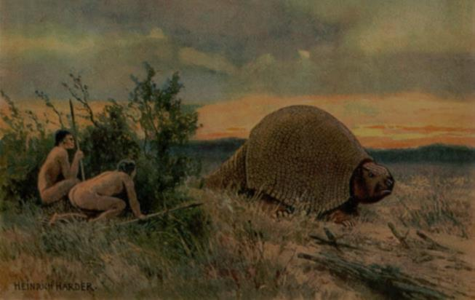
SOME EVOLUTIONARY PRESSURES
‘Hunting and gathering’ generates both animal and plant foods
Seasonal changes in availability would continually vary the relative contribution of the two food types
There are probably an inbuilt evolutionary ‘hungers’ for sugar, oils, salt and ‘meaty tastes’, because these drive you to eat more of the foods that provide them
Historically, cultures have tried to get as much as they can of items that satisfy these hungers, and the result was generally a good functional diet
It was extremely difficult to get ‘too much’ of the sought-for items
In modern societies, availability is essentially limitless
  Now it’s easy to have ‘too much’
  And many naturally do, with increasingly negative consequences

Slide 11
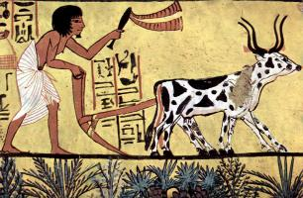
THE RISE OF AGRICULTURE
Once partially developed, its increased efficiency allows a larger population
After that there is no way back
  The great agricultural ‘trap’
Once you have a surplus, you can start to specialise
Tendency for stratification of society
Basic plant-based diets, grains and pulses and ‘default meat’
  More meat for the elites, less for the lower classes

Slide 12
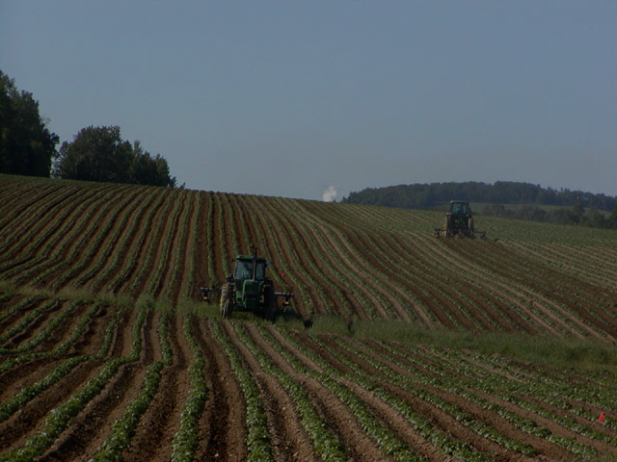
TRANSITION TO MODERN AGRICULTURE
It’s so productive, it becomes almost invisible!
Pre-modern food >50 % of time, effort, expenditure
Early modern period, large increases in supply
  Expanded agricultural areas
  Major increases in productivity per hectare and per worker, mostly through improved technology
  <10 % of population in farming
Post-modern consumer society ~10 % household expenditure on food and drink
  Much of this ‘discretionary’
  Considerable change of diet towards meat, sugar, prepared and processed foods
  < 5 % population in farming

Slide 13
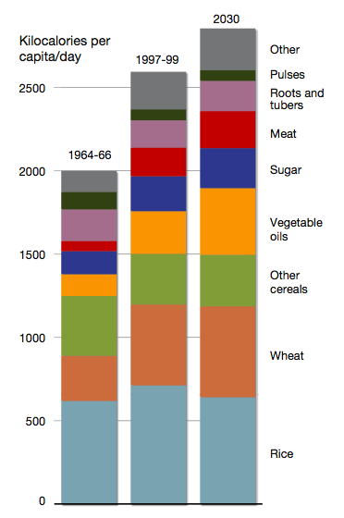
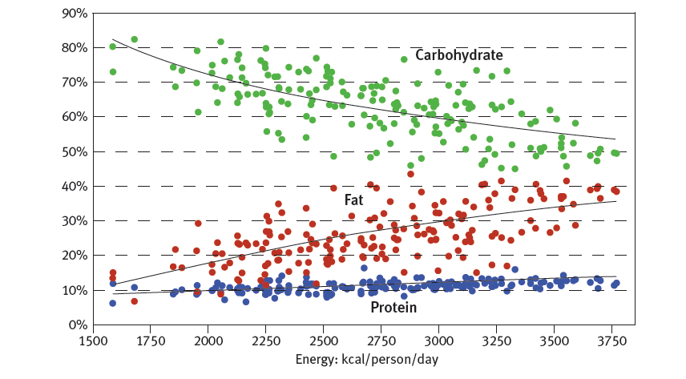
RECENT AND PROJECTED CHANGES IN DIETARY PATTERNS
TEND TO FOLLOW ‘EVOLUTIONARY HUNGERS’
Beddington et al. 2012
Nelleman, C. et al., (Eds)
The Environmental Food Crisis.
UNEP 2009.

Slide 14
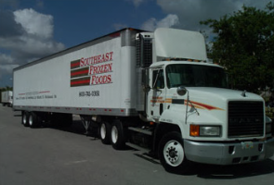
THE GLOBALISED FOOD SYSTEM
Most nations still supply most of their own food
With increasingly globalised supply chains
Professionalisation, diminishing role for peasants
‘Green Revolution’, agricultural chemicals, machinery, is the norm
Probably present world population level is dependent on Haber-Bosch nitrogen
‘Food miles’ for all components tend to increase
  But should not be over-emphasised
Complex mixtures of ingredients
Supply-push as well as demand-pull

Slide 15
SOME GEO-POLITICAL ASPECTS
The ‘South’ always seems to get the short straw
‘North’ agriculture declining proportion of GDP
  Yet highly productive
The North could feed itself
  In the short term, climate change often an advantage
The ‘South’ is in greater trouble
  Climate change a critical and increasing threat

Slide 16
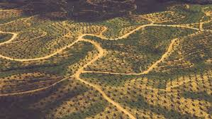
FREQUENT PROBLEMS FOR FOOD IN THE SOUTH
Fast growing populations
Poorer soils
Water problems
Ineffective distribution
Weak infrastructure
Low purchasing power at bottom end
Neo-colonial land purchases
Knock-on effects of North’s purchasing power and perverse preferences
e.g., feed for livestock, edible oils, biofuels, air-freighted luxuries
Physical problems associated with climate change

Slide 17
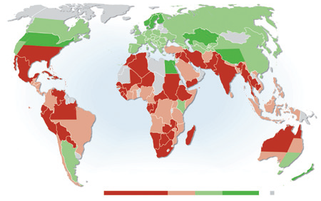
LIKELY SITUATION IN 2050
Lower productivity
Higher productivity
Beddington J, Asaduzzaman M, Clark M, Fernandez A, Guillou M, Jahn M, Erda L, Mamo T, Van Bo N, Nobre CA, Scholes R, Sharma R, Wakhungu J. 2012. Achieving food security in the face of climate change: Final report from the Commission on Sustainable Agriculture and Climate Change. CGIAR Research Program on Climate Change, Agriculture and Food Security (CCAFS). Copenhagen, Denmark.

Slide 18
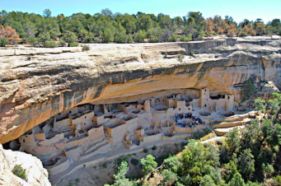
HISTORICALLY, AGRICULTURAL
CIVILISATIONS HAVE OFTEN ‘COLLAPSED’
Many possible mechanisms of collapse
But very often they simply overreach their resources relative to growing populations
Depleted and damaged resources lead to vulnerable food supplies
  eventually pushed to breaking point by some external event
Such collective malign outcomes were often hard to foresee, plan for, and forestall

Slide 19
COULD IT HAPPEN NOW?
We now have a globalised agrarian civilisation
Is it safe from collapse?
Better technology, means of foresight
‘Selective collapses’ perhaps more likely
Historically, stratified societies sometimes survived collapses by ‘sequestering mortality in the lower classes’ Rogers DS, Deshpande O, Feldman MW (2011) The Spread of Inequality. PLoS ONE 6(9): e24683. doi:10.1371/journal.pone.0024683

Slide 20
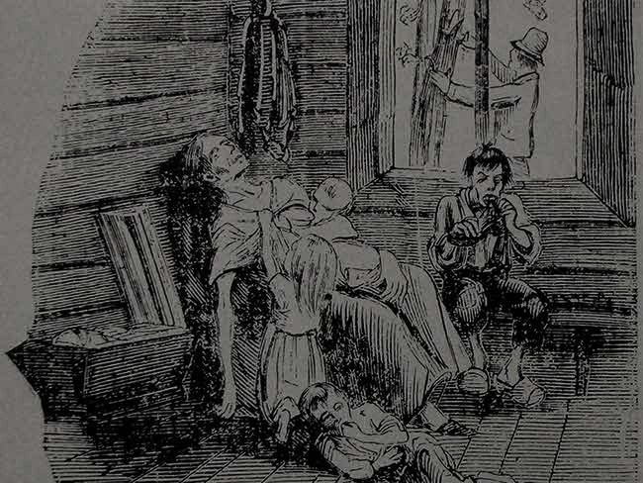
THE IRISH FAMINE
Peasant culture, self-provision
Reliance on one crop
No general provision for emergency relief or sharing available food
Prices were high, and people simply could not afford to buy food
‘Starvation amid plenty’
It couldn’t happen now….?

Slide 21
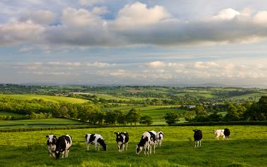
THE UK TODAY
UK produces about 55% of its own food, including most ‘staples’
Could easily do far more, but it is often cheaper to import
Excellent infrastructure and distribution system
Typical households spend 11% on food and drink (compare 5% energy, 14% transport)

Slide 22
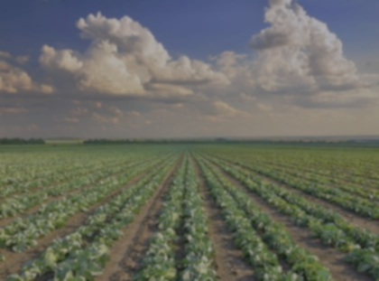
COULD THE UK FEED ITSELF?
Question first asked by Mellanby in 1966
Answer, yes with minor changes of diet
Revisited by Fairlie in 2009; ZCB in 2010
Answer: again yes, and gets easier in proportion to livestock reduction
Yields have improved greatly, even since the 60s, and could still further, perhaps with reduced inputs
There is a serious question about whether the UK should be a net exporter of food

Slide 23
WHAT COULD THREATEN UK FOOD SECURITY IN NEXT TEN YEARS?
Probably not much
More ‘anxiety’ or inconvenience than threats to life and limb
Prices might vary surprisingly
Simply import to make good, at a price?
Peak oil?

Slide 24
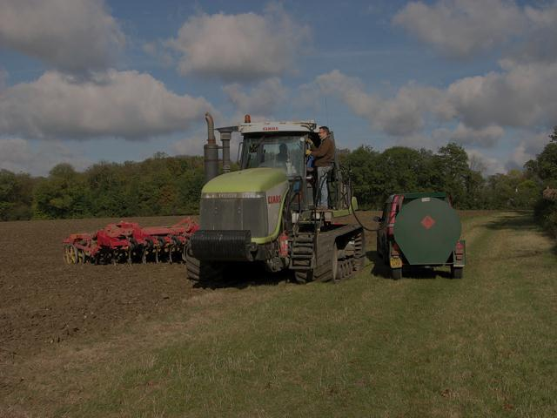
ENERGY AND AGRICULTURE
A PSEUDO-PROBLEM?
Most farms apply more energy to food production than the energy content of the food
  “Eating oil”
Is this a problem?
Total energy consumption of the UK ag sector (~150PJ) is about 1.5% of the whole (~10EJ)
Most of this is in ‘inputs’ such as fertiliser
Actual on-farm energy is small
If there were food shortages, agriculture would certainly be prioritised

Slide 25
BUT IMAGINE A WORST-CASE
Simultaneous occurrence of:
Severe droughts in N America, Russia
Storms and weather extremes during UK growing season
Volcanic eruption depresses sunlight, temperatures, crop yields (compare 1816)
Pandemics of disease affect wheat, livestock
Breakdown of computer retail stock-control
  Perhaps assisted by cyber-attack
Delivery drivers strike
Panic buying and hoarding
Acute loss of some ecosystem services
  e.g., pollination, pest control

Slide 26
A more optimistic scenario:
ZERO-CARBON BRITAIN 2030
An attempt to ‘design’ a sustainable UK
Includes food and land use system designed to reduce impacts on all ‘planetary boundaries’ and improve diet and food security
Too good to be true?

Slide 27

THE ZCB SCENARIO CLAIMS TO…
Decarbonise the UK economy
  Providing most of its own sources and sinks
Reduce N and P excess to sustainable levels
Conserve regional biodiversity
Reduce pressure on other regions
Improve overall diets
Increase energy security
Increase food security

Slide 28
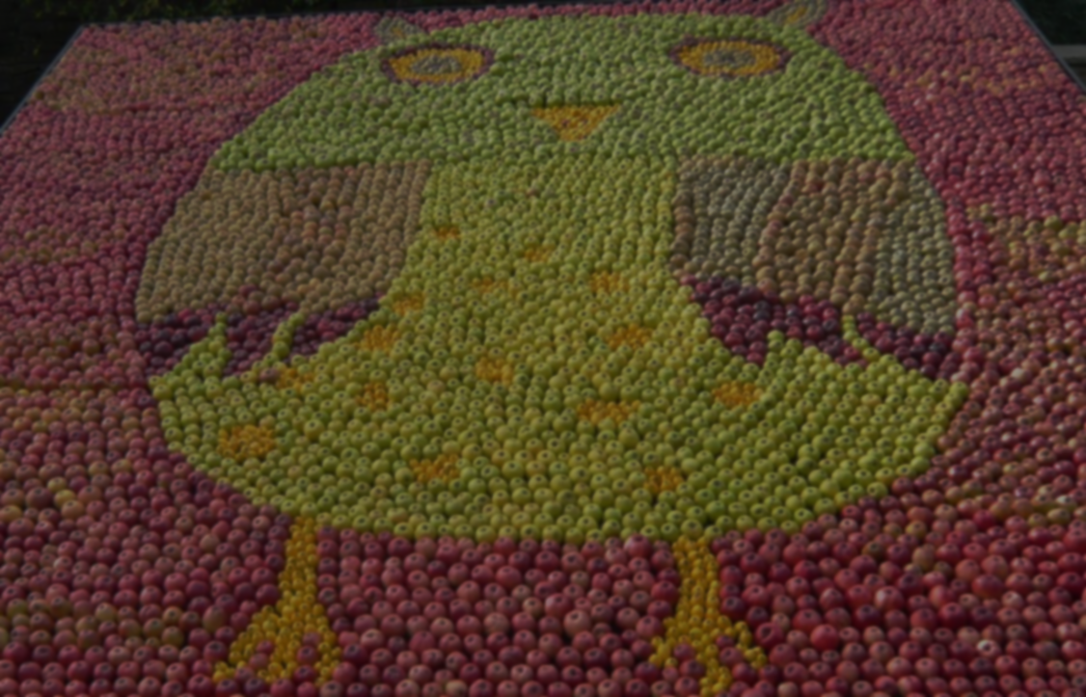
OVERALL PROSPECTS FOR THE UK
IN THE ZCB2030 SCENARIO
There is no question that the UK can ‘feed itself’. It is just a matter of what average diet it adopts, and what else it wants to do with the land.
ZCB2030 showed that the UK can produce all its own essential foods. 20% of ‘luxuries’ can be imported, but they are not necessary
In the event of a ‘collapse’ in world order or international trade, the UK could still have a very high level of food security
Food prices would probably be higher on average, with high-carbon foods even more expensive, making it difficult for most people to maintain a ‘traditional British diet’
There is no reason to suppose that the ‘food industry’ will be greatly different from today, although the effects of carbon prices will affect the product mix

Slide 29
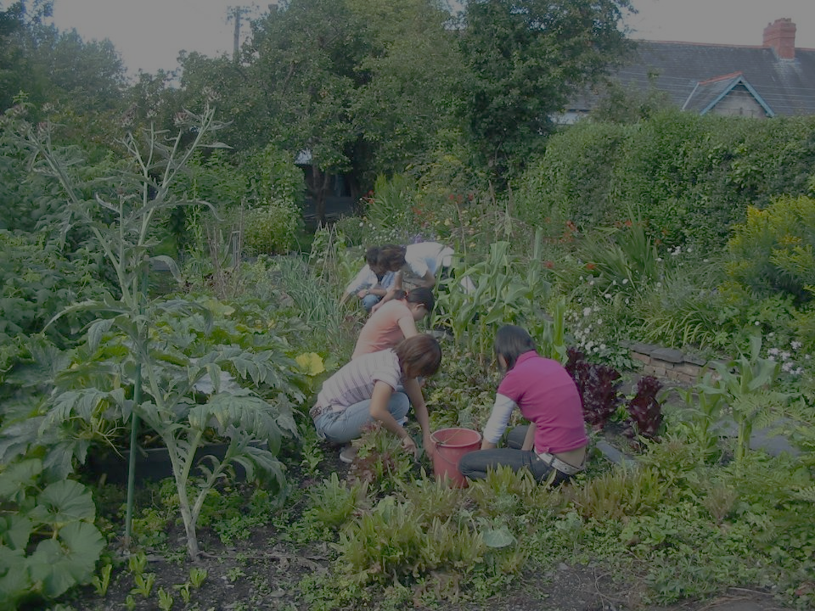
GROWING YOUR OWN
Not usually an economic matter
  Average household food expenditure 11%
Hard to grow ‘staples’: starch, protein, oil
  And farmers grow them very cheaply
But you can grow vegetables and fruit
  Just the bits we are supposed to be eating more of
You should allow it to influence your diet
  “Meat ‘n ten veg”; “15 a day”
Improves your health and longevity
  But not your budget
  Well not much, unless you are very poor

Slide 30
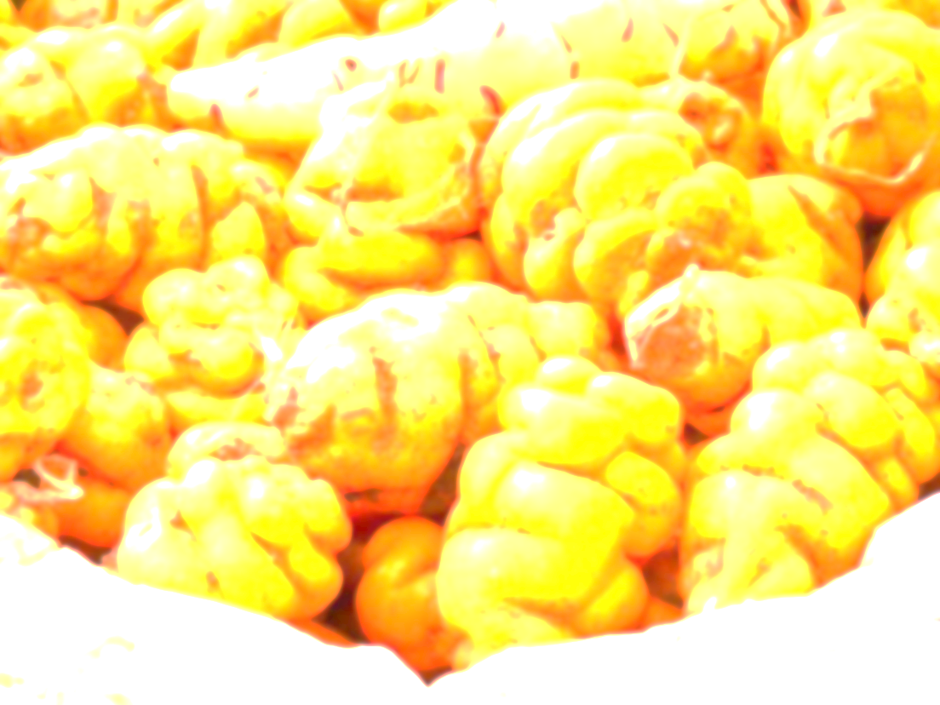
THE PREPPER’S GARDEN
If it were necessary, you’d probably have greater worries than starvation. However…
Loads of spuds, good storers, different varieties, save seed, harvest before blight
Other substantial roots, swedes, carrots, Jerusalem artichokes, oca, parsnips
Legumes for drying, Borlottis, marrowfats
Pumpkins for oil. Possibly sunflowers
Several brassica types for greenery/vitamin C
More space? Culinary veg, salads
Longer-term, fruit and nut crops
Livestock: bees, poultry

Slide 31
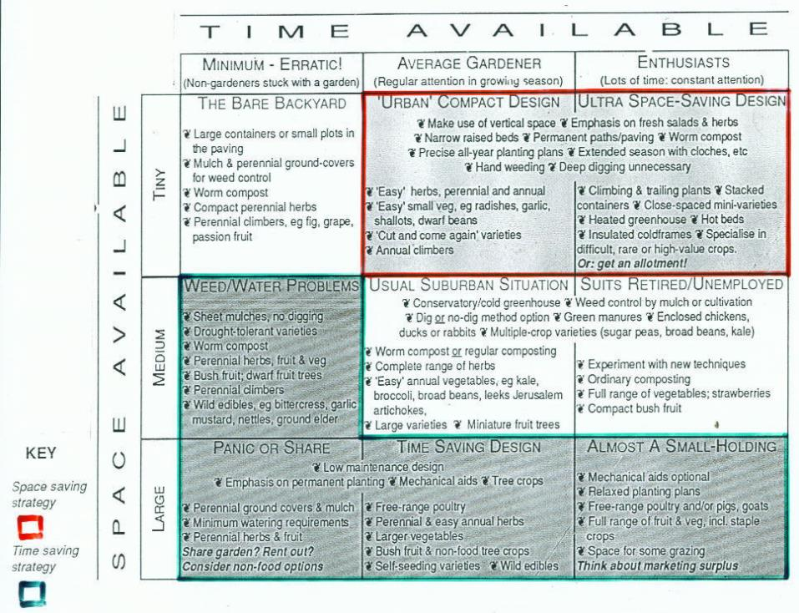
AND MATCH
YOUR TIME AND SPACE

Slide 32
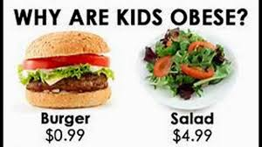
FINALLY…FOOD QUALITY?

Slide 33
WE HAVE BEEN TRYING TO FIND FOODS AND DIETS THAT MEET MANY DIFFERENT REQUIREMENTS
LOW LAND INTENSITY AND OTHER IMPACTS
Sugar, alcohol
LOW GHGE
Some wild foods
Drugs
Grains, vegetables, pulses
Oils,
Paddy rice,
Some wild fish
Greenhouse crops
Nuts, some fruits, eggs,
farmed fish
HIGH NUTRITIONAL VALUE
Most livestock products

Slide 34
BUT MOST PEOPLE CARE ABOUT DIFFERENT FACTORS
COST
Boiled potatoes, roots
Grains, vegetables, pulses, wholegrain bread and flour, seaweed, wild foods
Sugar, jam,
white breads, refined carbohydrates,
tea and coffee,
fatty foods, processed meat
Milk, cheese, oils, eggs
HEALTH
Oily fish
lean meat,
offal, fruit
PALATABILITY
Carcass meat

Slide 35
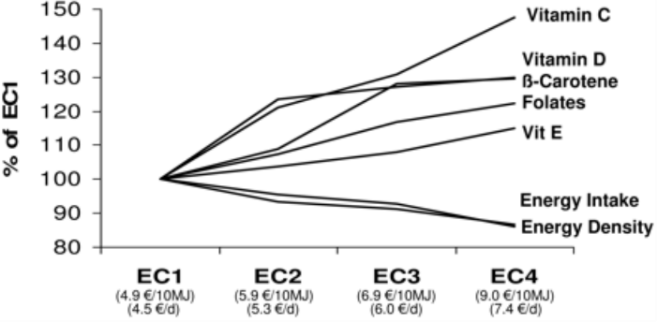
INCOME AND MICRONUTRIENTS
Andrieu E, Darmon N, Drewnowski A. Low-cost diets: more energy, fewer nutrients. Eur J Clin Nutr 2006;60:434–6.

Slide 36
FOOD ITEM COSTS PER GDM
Economically rational for poorer people to construct diets from the cheap end of the scale
My ‘tea’
Lunch with grandma

Slide 37
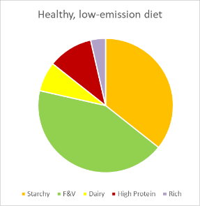
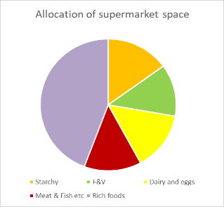
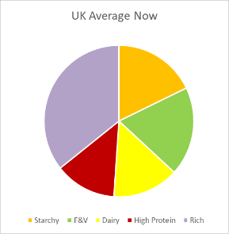
BROAD PATTERNS OF DIETARY COMPONENTS

Slide 38
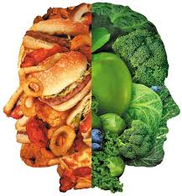
CLASS AND DIETS
There is a vast literature showing strong correlation between socio-economic indicators and diets
On the whole, poorer people seem to have ‘worse’ diets, both in health and environmental terms
Or, are these diets considered ‘worse’ because nutritionists are all middle class?

Slide 39
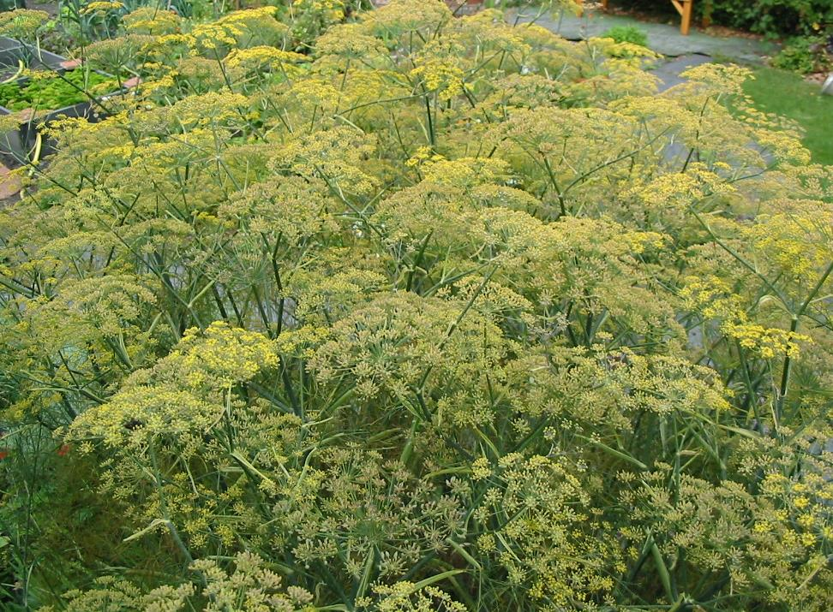
AND NOW
For the brandy and cigars

Slide 42
Speculative plot of responses to increasing carbon price
RUMINANTS
NON-RUMINANTS
ENERGY CROPS
FAIRLIE’S “DEFAULT LIVESTOCK” LEVEL
SEQUESTRATION CROPS
£10/t
£50/t
£500/t

Slide 43
In summary, the available evidence suggests that the consumption of whole grains, lean meats, fish, low-fat dairy products, and fresh vegetables and fruit was consistently associated with higher SES groups, whereas the consumption of fatty meats, refined grains, and added fats was associated with lower SES groups.
Does social class predict diet quality? Nicole Darmon and Adam Drewnowski. The American Journal of Clinical Nutrition, 87, (5), 1107–1117 (2008).

Slide 44
APPENDIX
Some specific issues in food security

Slide 45






CURRENT UK AND OVERSEAS LAND USE
Based on CAT (2013); Weighell (2011); and Audsley et al. (2010).
Each square 1 Mha

Slide 46
PROPOSED LAND USE IN ZCB SCENARIO 2013
PLUS USE OF EXTRA-TERRITORIAL SINKS
WILD/
UNMANAGED
SEQUESTRATION
IMPORTED ‘LUXURIES’
PURCHASED SINKS
(INCLUDING BIOMASS IMPORTS)
FOOD
ENERGY

Slide 47
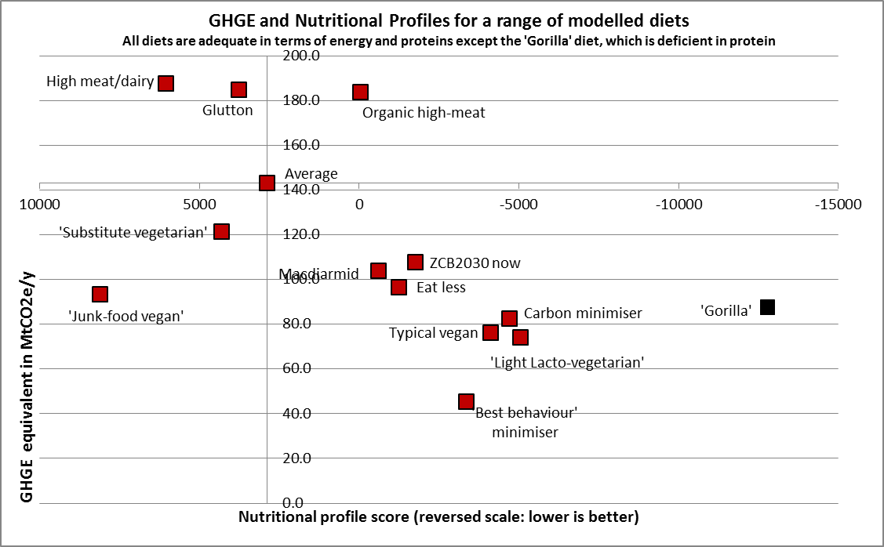

Slide 48
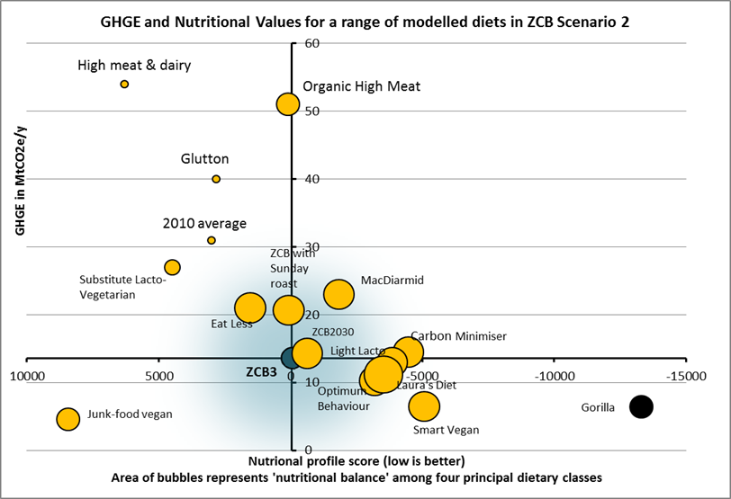

Slide 49
SOME OTHER ISSUES
(will be cut if time is short, attached as an appendix)
Indirect global impacts
Soya products
Biofuels
Food waste
Food miles
Fish

Slide 50
INDIRECT INTERNATIONAL IMPACTS
Raised demand finds the cheapest supply
…and the cheapest support chains for that product
This is often in poor countries, where high prices can trump local requirements
The rich can easily afford to corner ‘expensive’ resources that displace local cheaper resources
Examples include soya production for animal feed, biofuels, oil from oil-palm plantations

Slide 51
SOYA PRODUCTION
The soya bean has excellent protein content
It produces a lot of oil and protein per hectare
About 90% is used for animal feed, fish food, biodiesel
This is the main source of pressure to increase area planted with soybeans
Only about 10% is directly used by people, and increasing this would deliver greater food security, and other benefits

Slide 52
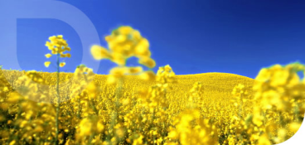
BIOFUELS?
EU and other bodies specify minimum levels of renewable liquid fuels
This is supposed to be an emission-reduction measure
‘First generation’ seed crops are used, poor return on energy investment
Tends to exploit the cheapest supply chains, for example soy and palm oil, often created by displacement of natural forests or local subsistence crops
Result is a noticeable rise in food prices
But (so far) a small effect compared with livestock

Slide 53
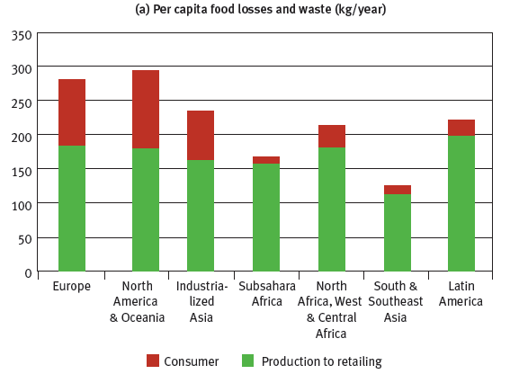
FOOD WASTE
In the UK at least 22% is wasted, probably much more
Less is wasted where food is more valuable
Waste of high carbon-intensity or high land-intensity foods is proportionately more serious for indirect effects
A cost-effective area for improvement
Responds to shortages!
Source: Beddington et al., 2012

Slide 54
ARE ‘FOOD MILES’ A SIGNIFICANT FACTOR?
Usually not, relative to other things
They usually account for less than 10% of the life-cycle GHG emissions
Sometimes distributional problems affect food security in countries with a weak infrastructure
‘Local’ cuts both ways in terms of food security: who gets the ‘local’ food, and who starves?

Slide 55
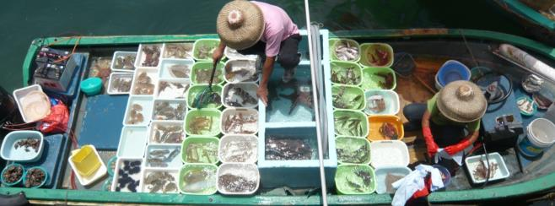
FISH
There is definitely a sustainable level of yield for most marine species
Yet most fisheries are over-exploited
Changing population-structure, damage to ecosystem functioning, potential collapse of resource
Not at all surprising: classic ‘Tragedy of the Commons’
Locally important, but not universally essential for nutritional requirements

Slide 56
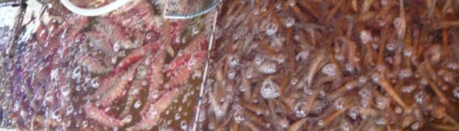
MORE FISH
Fish farming has increased to fill a gap in demand
But farmed fish are partly fed on….fish
In overall environmental terms, usually better than grazing livestock
But not an instant technical fix for protein demand
Like meat, fish should (and will) probably be regarded as a luxury for special occasions
Possibilities for plant-based feedstuffs
Or ‘artifishal’ fish?

Slide 57
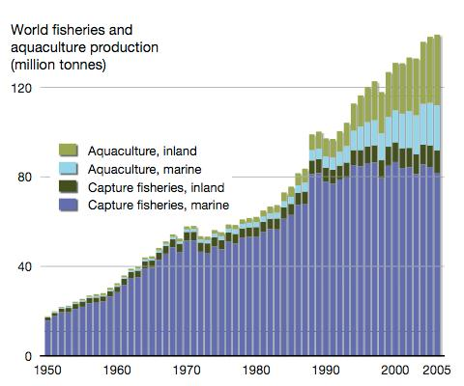
A GOOD EXAMPLE OF A TECHNICAL FIX TO MAINTAIN SUPPLY OF FISH
Nelleman, C. et al., (Eds)
The Environmental Food Crisis.
UNEP 2009.

Slide 58
SUPPLEMENTARY SLIDES
Extra information related to food security

Slide 59
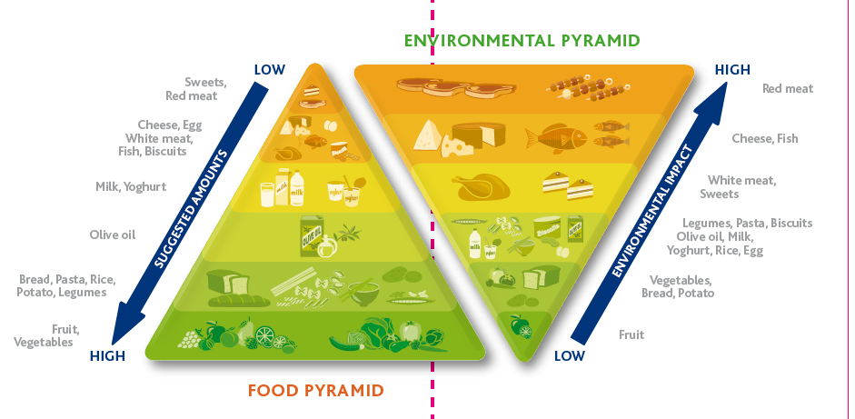
FOOD QUALITY: ‘DOUBLE FOOD PYRAMID’
PROPOSED BY BARILLA CENTER http://www.barillacfn.com/images/download/positionpaper_barillacfn_double-pyramid.pdf

Slide 60
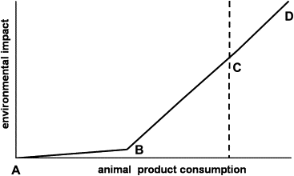
‘DEFAULT MEAT PRODUCTION’
Cf. Simon Fairlie, Meat: A Benign Extravagance, Permanent Publications, 2010
Elferink, E.V., S. Nonhebel and H.C. Moll (2008), J. Cleaner Production 16 (12) 1227-1233.

Slide 61
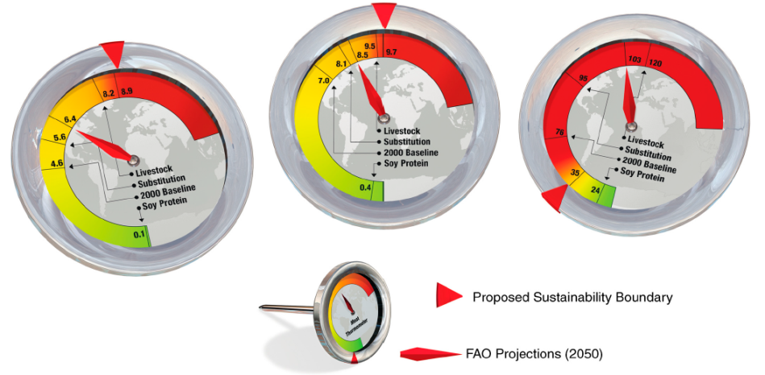
Three planetary boundaries under four diet/land-use scenarios
N.Pelletier and P.Tyedmers (2010) www.pnas.org/cgi/doi/10.1073/pnas.1004659107
Biomass appropriation
GHG emissions
Reactive nitrogen

Slide 62
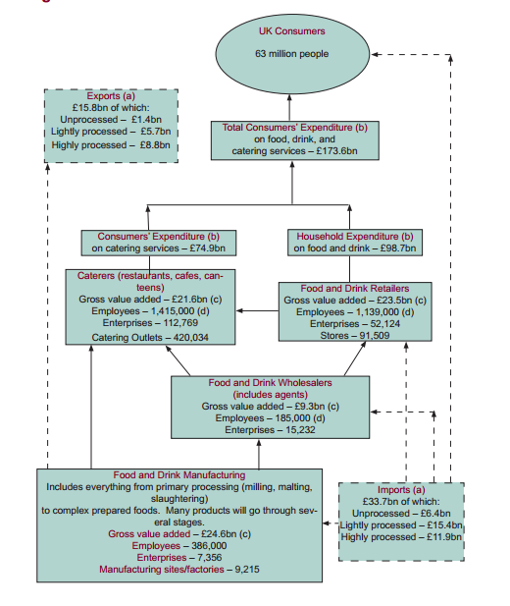
UK FOOD BEFORE AND AFTER THE FARM GATE:
AGRICULTURE TINY IN MOST RESPECTS, BUT ENVIRONMENTALLYVERY SIGNIFICANT
UK Agriculture
Gross value added £10bn

Slide 63
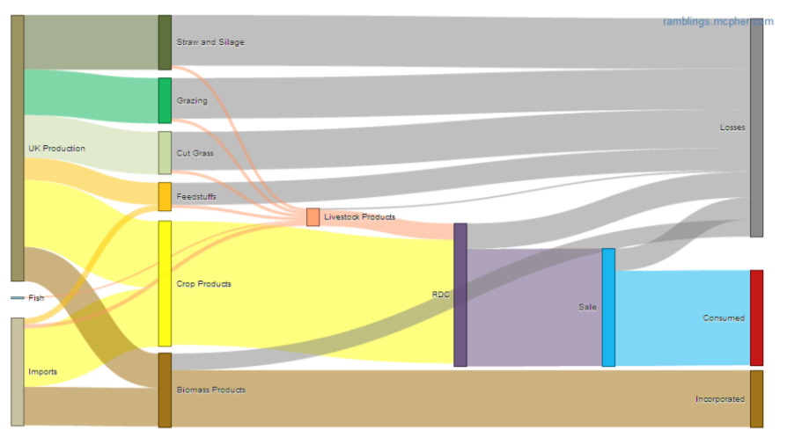
SANKEY DIAGRAM OF BIOMASS FLOW IN THE UK

Slide 64
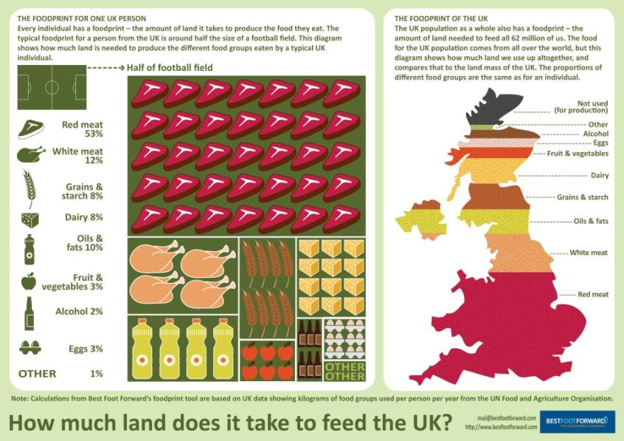
LAND REQUIREMENTS FOR UK FOOD
From Best Foot Forward

Slide 65
DIETARY EMISSIONS UNDER DIFFERENT ASSUMPTIONS

Slide 66
SHIFTING DIETS
Beddington et al., 2012

Slide 67
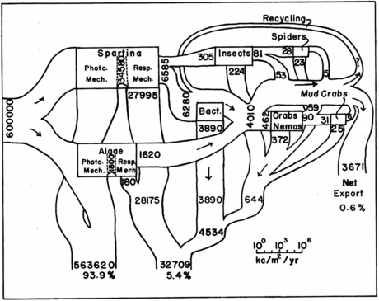
TROPHIC PYRAMIDS
What’s wrong with this classic diagram?
J. M. Teal., Energy flow in the salt marsh ecosystem of Georgia.
Ecology, 43:614-624, 1962.

Slide 68
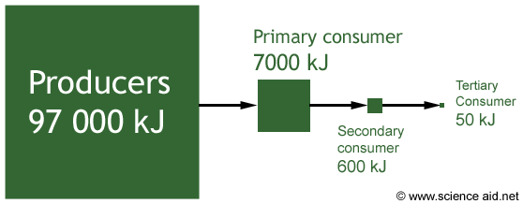
Effect of moving up the trophic pyramid rather than down
“The loss of calories by feeding the cereals to animals instead of using the cereals directly as human food represents the annual calorie need for more than 3.5 billion people”.
Nelleman, C. et al., (Eds)
The Environmental Food Crisis. UNEP 2009.

Slide 69
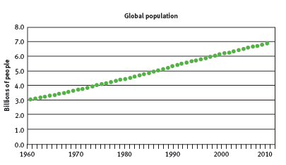
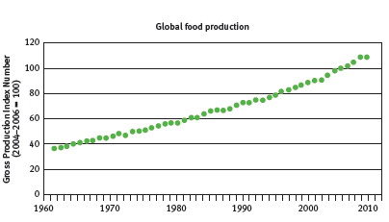
FOOD vs POPULATION
On the whole, we are keeping up, but is it sustainable?
140% RISE
210% RISE
Source: Beddington et al. (2012)

Slide 70
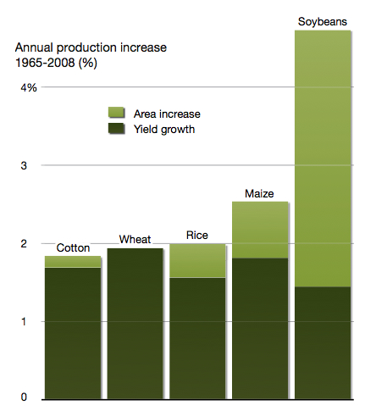
EXTRA PRODUCTION
Much going to livestock, much entailing unsustainable land use change
Nelleman, C. et al., (Eds) The Environmental Food Crisis. UNEP 2009.

Slide 71

THE UK:
FOOD AND LAND SYSTEM
Most land is used for agriculture, producing raw food ‘commodities’
Most of that is grassland
  A fair amount of this is ‘horsiculture’
There is an increasing amount of woodland
The east is flat, dry, arable
  Crops, grains
  Non-grazing livestock
The west is hilly, wet, grassland
  Grazing livestock, dairy
Map courtesy
http://www.sidthomas.net/Agriculture/animalprod.htm

Slide 72
UK FOOD STATISTICS
Recalculated from DEFRA Food Statistics Pocketbook, 2011 and Audsley et al., Food, Land and Greenhouse Gases, CCC 2011
% OF UK TOTAL | UK AGRICULTURE | UK FOOD SECTOR “AFTER FARM GATE” | NET IMPORTS
ADDED VALUE | 0.6 | 13 | 2
EMPLOYMENT | 1.5 | 12.5
ENERGY | 1.6 | 14
GHG EMISSIONS | 9 | 8 | 5
RAW VALUE % OF TOTAL | 58 | 100 | 42

Slide 73

‘OTHER’
ALCOHOL
FRUIT AND VEG
OILS
GRAINS
EGGS
DAIRY
WHITE MEAT
LAND REQUIREMENTS OF ALL FOOD PRODUCTION FOR THE UK
RED MEAT

