Slide 1
CAT SHOW PART 2

Slide 2
SOME OF THE THINGS WE DO NOW
Green Buildings
Renewable Energy
Sustainable waste treatment
Functional eco-friendly landscapes
Eco-tourism
Green trading activities
Education
Publications
Information service
Consultancy
Research
Starting new enterprises

Slide 3
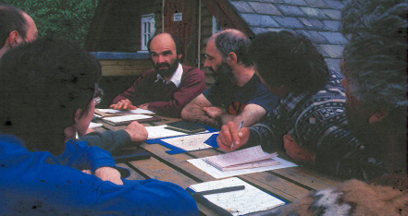
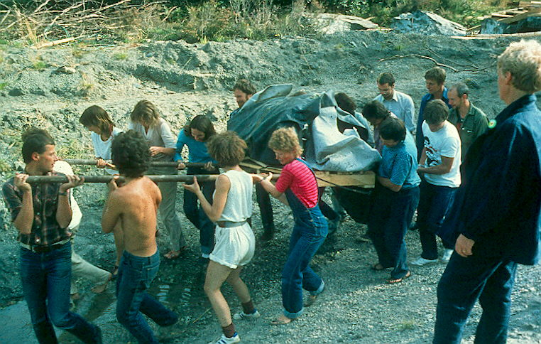
WORKPLACE DEMOCRACY
Notes:
There are lots of meetings (top left) but we try not to have more than are strictly necessary! Big physical activities with lots of people (bottom left, delivering a pond liner) are always fun but do not seem to happen so often these days. Is this the way of the world?

Slide 4
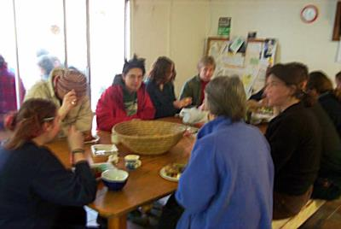
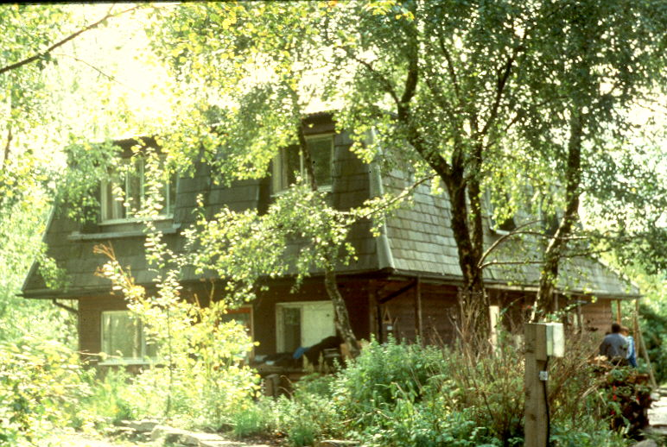
WE STILL EAT TOGETHER
Notes:
Bottom right shows the community house and top left what happens there every lunch time. We used to take it in turns to cook staff meals but the results were erratic and now we prefer to employ someone who knows what they’re doing

Slide 5
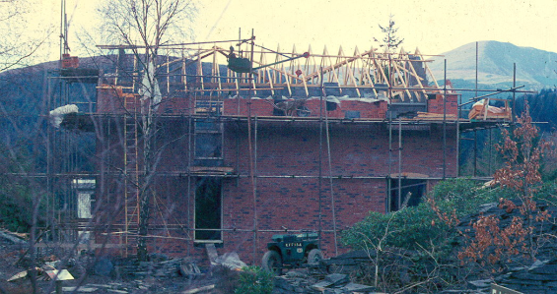
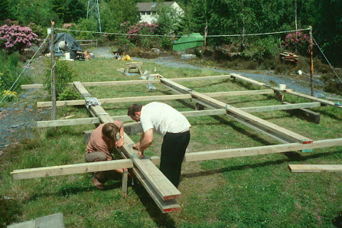
GREEN BUILDING The three little pigs in reverse?
The 1970s: Building with brick and stone
The 1980s: Building in wood
What about the 1990s?
Surely not...

Slide 6
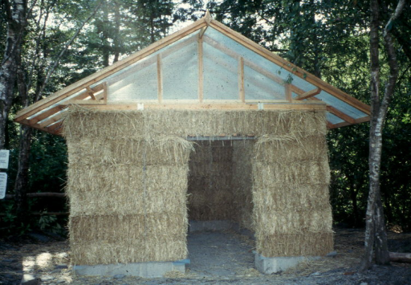
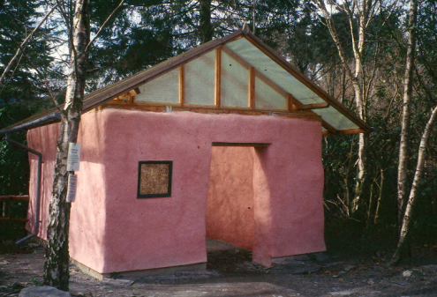
Straw!

Slide 7
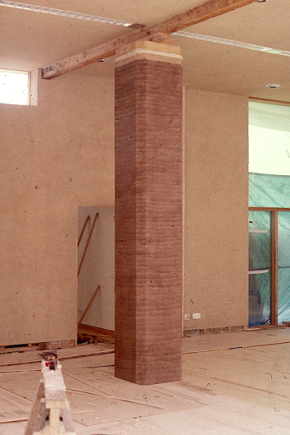
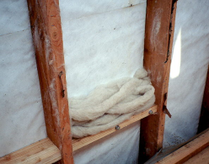
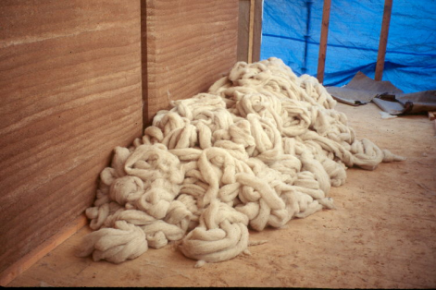
2000: EARTH AND WOOL
Notes:
The new shop and information centre completed in 2001features rammed earth as the structural material, and processed sheep’s wool for wall insulation. An unusual feature of this large building is that no cement or concrete was used.

Slide 8
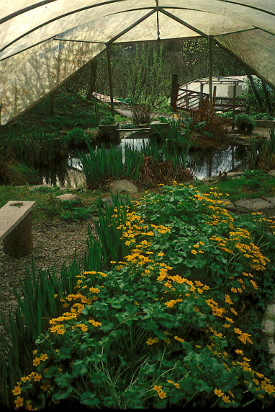
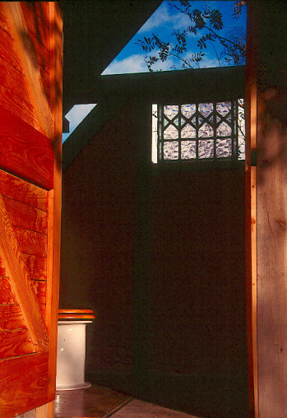
BIOLOGICAL TOILET SYSTEMS...
Can be picturesque
Notes:
Left: A European adaptation of the Australian DOWMUS dry-toilet system. The pedestal is a neat ceramic bell occupying a clear space uncluttered by pipes, cisterns and drains.
Right: One of the two aquatic pant treatment systems for site sewage.

Slide 9
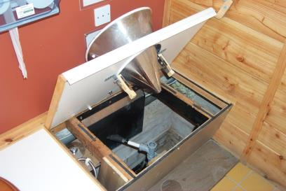
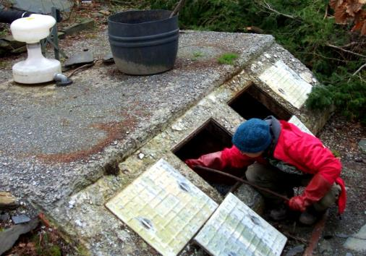
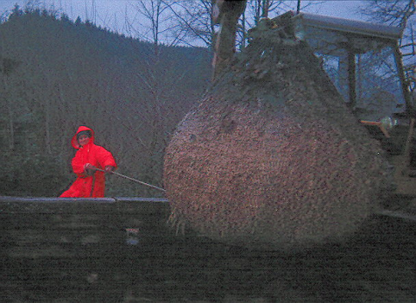
…but can also be technically (and physically!) demanding
Notes:
We are crazy about experimental toilets, but there are always more problems to solve .
Top centre: An experiemntal un-missable (?!!!) urinal set-up being installed in a state-of-the-art twin-vault composting toilet system. Perhaps we are too far ahead of our public here….
Bottom right: Poo heroine Dr. Judith Thornton struggling with two tons of semi-composted sewage solids.
Bottom left: The white hour-glass-shaped object is a cunning device that centrifugally separates solids and liquids from a WC. Liquids are run off for separate treatment, while solids fall into the composting chambers. Alex, one of the Biology Depts’s volunteers, is carrying out the somehow archetypal process of ‘knocking the peak’, that is pushing over the steep-sided stalagmite of sticky solids so they do not foul the separation device.

Slide 10
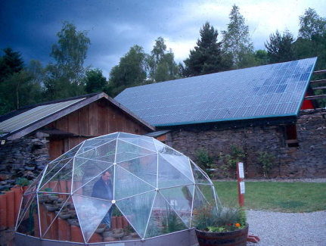
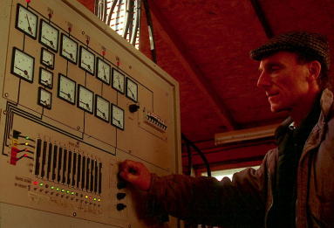
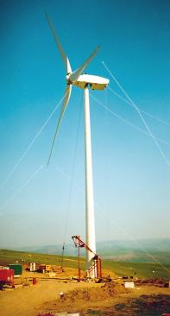
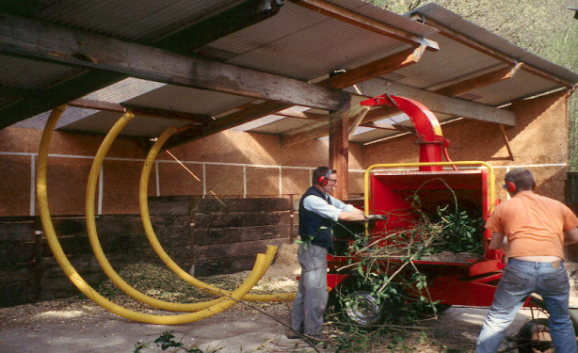
SMALL SCALE RENEWABLE ENERGY (‘2nd generation’)
Photovoltaics
Control systems
Grid-linked wind turbines
Biofuels
Notes:
By now we know what works and what is worth the effort put into it.
Clockwise from top left:
The largest roof-integrated PV array in the UK (so far, still a tiddler relative to what’s needed). This is a 13kW(p) installation with optional grid-connection. It fills an important hole in our supply system, which otherwise tends to function best in winter and in rainy weather. The more different sources of renewable energy you have the more likely there will be an adequate supply, and the less backup is required.
Engineer Clive Newman setting the day’s ‘rules’ for matching electricity supply and demand. Energy management is as important a part of sustainable energy as renewable sources and efficiency.
Chipping for winter fuel. Our heating is divided approximately equally between solar, wood and conventional gas. Solar does most of the spring/summer/autumn; wood chips do most of the winter. Heat is distributed as hot water through a heat main.
The MS4 turbine is a prototype downwind 600kW machine and has proved to be another British lemon. Good try, but we shall soon replace it with a sensible Danish turbine. The machine is connected only to the grid and we currently use it for teaching as well as selling electricity.

Slide 11
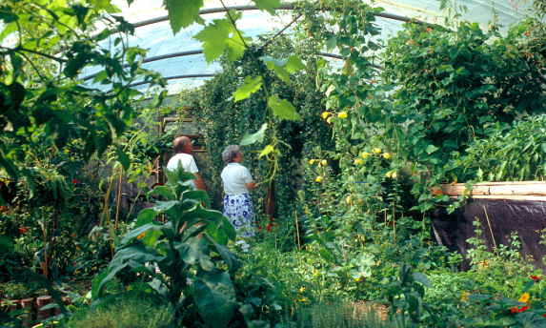
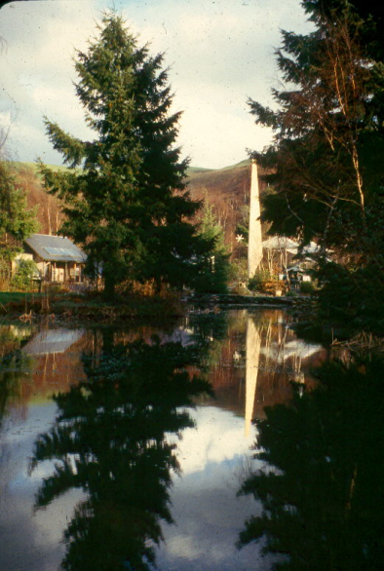
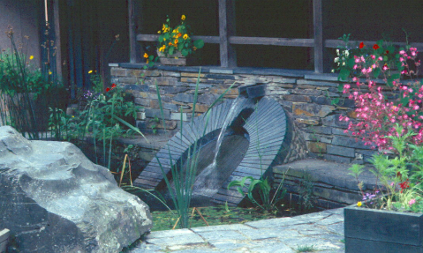
FUNCTIONAL LANDSCAPES
Notes:
We don’t do much ‘landscaping’ for its own sake. It’s more a matter of taking an aesthetic approach to functional requirements.
Top left shows a display greenhouse with mostly edible plants.
Far right shows the lake constructed to provide a reservoir to run the Cliff Railway, and which also contains edible fish and many habitats.
Bottom left shows the point at which the water from the lake enters the railway system, through a grille to exclude debris mounted in an arch of dressed slate. Above the arch is a chute through which water can be recirculated back into the lake, powered by the excess energy from the regenerative hydraulic braking system.

Slide 12
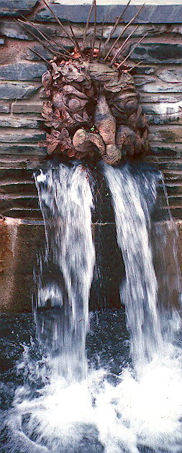
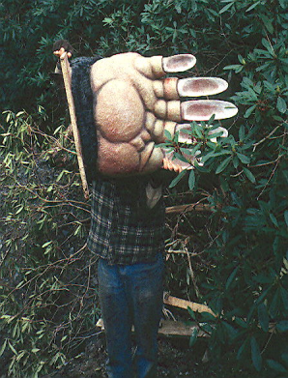
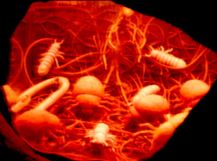
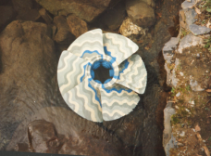
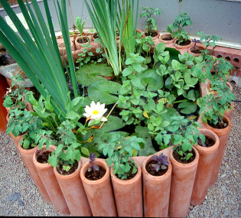
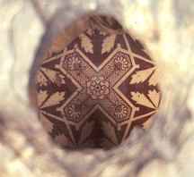
WITH ART AND FUN
Notes:
But sometimes we cannot resist an element of whimsy.
Clockwise from left:
The clawed hand of the giant mole who astonishes children in the underground ‘mole-hole’.
Some of the subterranean decomposer creatures who inhabit the mole-hole.
Water-turbine runner decorated and archly relabelled as a pre-Cambrian fossil.
‘Green Man’ gargoyle carved by a visiting sculptress.
Pond in greenhouse using unused drainage pipes.
Secret Victorian tile seen through a hole in the stonework.

Slide 13
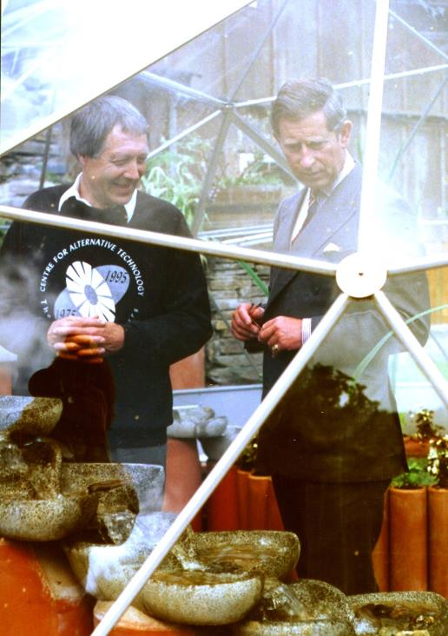
AND (occasionally) DISTINGUISHED VISITORS

Slide 14
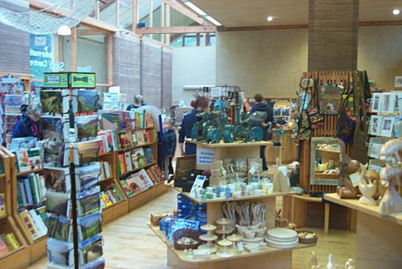
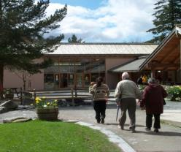
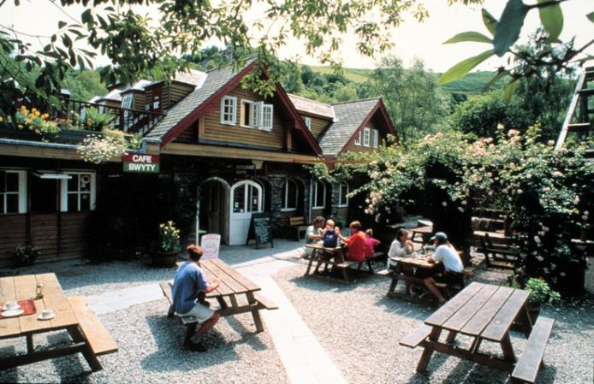
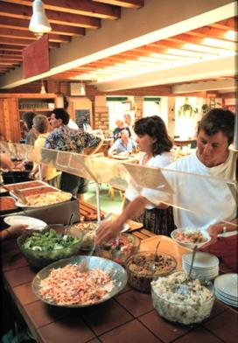
NEW SHOP AND RESTAURANT
Notes:
The two bottom pictures show the latest state of the engine-shed building seen at the beginning of the show. The upper pictures show the exterior and interior of the new earth-column building

Slide 15
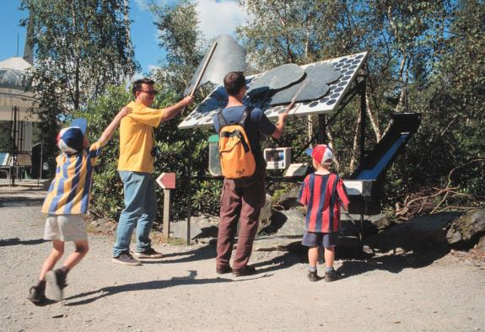
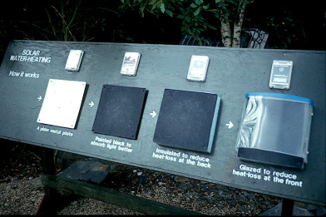
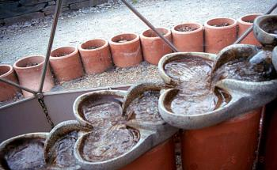
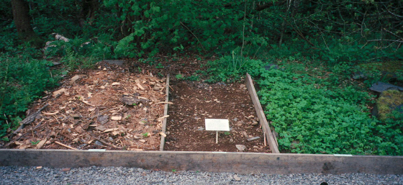
ENLIGHTENING DISPLAYS
Notes:
Getting green ideas across to people on holiday is a tricky number, and the message we intend does not always get through. We try a bit of everything.
Top left: Pump operated by photovoltaic panels. With clouds on sticks you can make the pump stop,and then the penny drops.
Top right: Simple demonstration of the physics of solar heat collection. White plate, black plate, black plate with insulation, black plate with insulation and transparent cover, each hotter to the touch than the previous one.
Bottom right: Demonstration of how to get rid of a pernicious weed with a loose mulch. It was actually working right in front of your eyes.
Bottom left: An on-view experiment to see whether water conditioned by laminar, lemniscate flow in ‘flow-forms’ has any measurable difference from water which has undergone chaotic, turbulent flow.

Slide 16
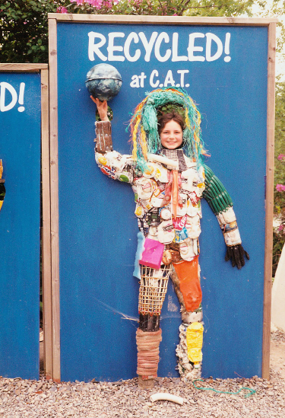
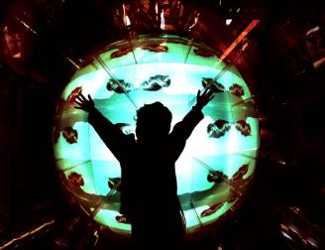
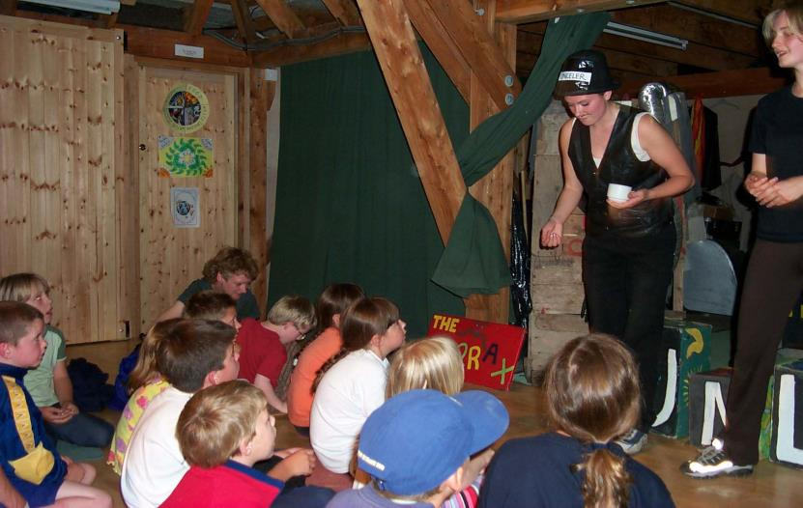
STUFF FOR KIDS
Notes:
Many of the current staff and volunteers came to CAT as kids and never forgot it. It’s a great place for kids and we like to give them a good time.
Top left: Scrap-being photo-op.
Top Centre:The ‘Gaiascope’ uses mirrors to present videos as kaleidoscopic images apparently on the surface of a 12 foot sphere. Kids are wowed by it.
Main pic: Activities with kids in the straw-bale theatre. The woman at left is Laura MacLennan whom we first saw as a three-year-old on her Dad’s knee. The woman at the right is the daughter of our head of fundraising, also with a drama degree. It’s often hard to get our kids to buzz off and go seek their fortunes in the Real World.

Slide 17
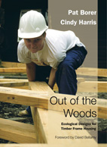
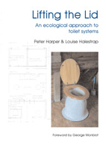
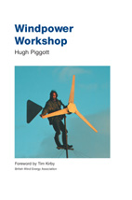
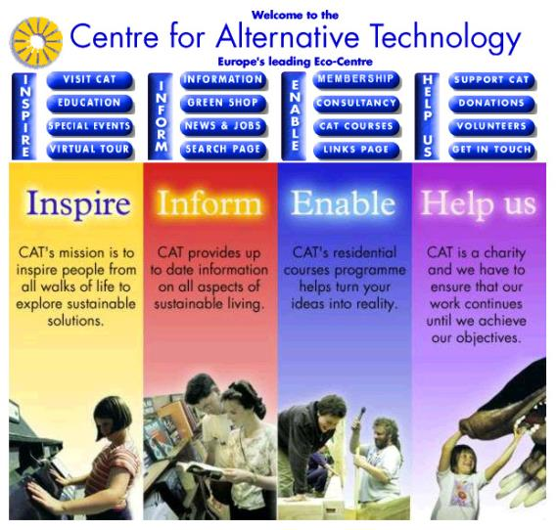
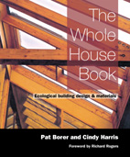
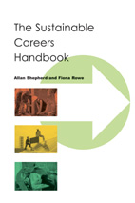
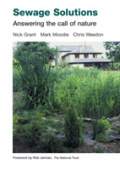
PUBLICATIONS AND WEB SITE
Notes:
The website is www.cat.org.uk and worth a visit or three.
There are currently about 100 publications in print, ranging from one-page tip-sheets to chunky books which are often definitive in their field.

Slide 18
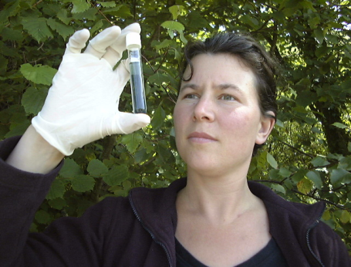
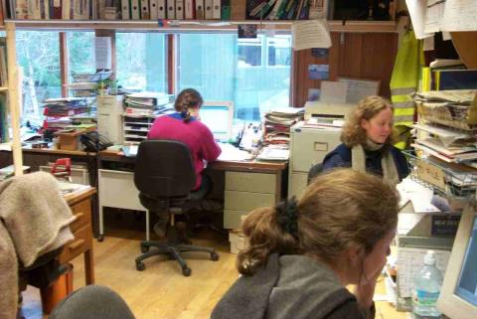
INFORMATION AND CONSULTANCY SERVICE
Notes:
The bottom two pictures show how the free consultancy system works, either through drop-in enquiries (right) or remotely via e-mail, post or telephone (left). We have a huge data-base. The Consultancy Service is not free, no sir! We do all sorts of stuff. For example my bio-colleague Louise Halestrap has just completed a study of how to compost large quantities of dogshit for the National Canine Defence League (top). My last consultancy job was to help design an organic farm for a Japanese burger chain!

Slide 19
HIGHER EDUCATION COURSES
Notes:
Originally we concentrated on school children, but today the emphasis is increasingly on university and postgraduate students.
We built the ‘Ecocabins’ (main picture) for school-age children to experience a week without mains services. They have their own water supply, sewage system, 24-V electricity from renewable sources; they have to cut their own wood for heating and cook for themselves. 8-year-olds find this really easy, but it seems to be harder for 15-year-olds.
Increasdingly the Ecocabins are being used by adults. Ritsumaikan University in Japan sends a class of students for month every year (bottom right) .
We are also running a master’s level course in Sustainable Building in collaboration with the architecture department of one of the London Universities (bottom left). This is almost too popular, attracting 60 students in 2001-2.

Slide 20
RESEARCH
Notes:
We are not well-endowed with fancy equipment for research. We tend to take the eighteenth-century Ben Franklin approach, that you can do an awful lot with simple bits of kit if you choose the right sort of problems.
We like to pick topics that for one reason or other are not being done elsewhere.
Clockwise from top left:
Leeks grown in papermill de-inking sludge, a non-toxic industrial waste material in search of a function. Without extra fertilisation you get healthy but tiny leeks about the size of scallions for which we are sure there is a market in gourmet cuisine. If you want big leeks, just irrigate with diluted human urine. Delicious!
Making a bran-based microbial culture from an extract developed in Japan. Makes compost smell like shoyu, and has many applications.
Renewable-powered DC refrigerator for medical use in remote locations. Uses 15W instead of 200W and can withstand a 24-hour interruption of supply.
Results of a study of temperature variations at different levels in a house, relative to comfort zones and heat sources, and the subjective reports of the occupants.
Prototype modular recycled-plastic compost system with different sizes and aspect ratios that can be mixed and matched to fit different gardens, families and organic waste streams.

Slide 21
NEW ENTERPRISES
Notes:
Pic at left shows our former electronics department, now proudly independent and occupying the first unit of the new eco-business park in the nearby town. The structure in the foreground is a bicycle shed with PV roof.
Top right shows one of our shops in the same town. This one seems separate but remains part of the general CAT economy.
Bottom right shows the Biomass Monitor (or ‘Bugmeter’ as everyone calls it) developed by our daughter company Aber Instruments. It electronically measures the volume of live cells in a fluid and is useful in applications like anaerobic digestion, breweries, pharmaceuticals etc.

Slide 22
NEXT?
A major new development incorporating conference centre, accommodation, seminar rooms and laboratories.
AND AFTER THAT?
Who knows?

Slide 23
COME AND SEE US
And
visit the web site
www.cat.org.uk

