Slide 1
The Centre for Alternative Technology

Slide 2
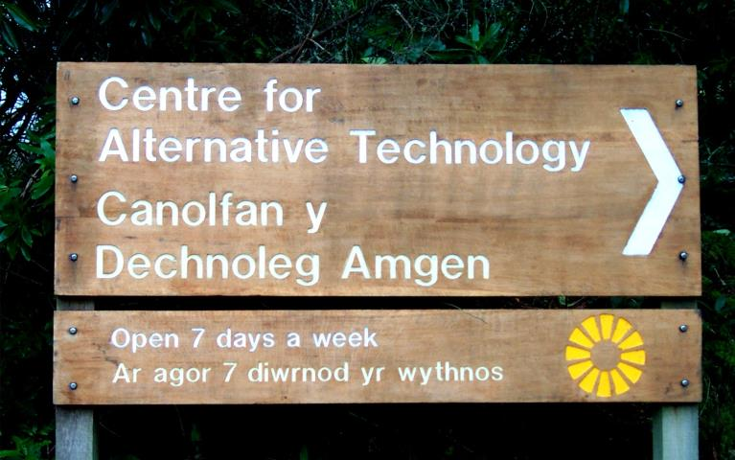
Notes:
This is the bilingual sign directing visitors to the Centre

Slide 3
HISTORY/DEVELOPMENT
70s: The Ecovillage Phase
80s: Education & Tourism
90s: Diversification
00s: Respectability?

Slide 4
THE EARLY DAYS

Slide 5
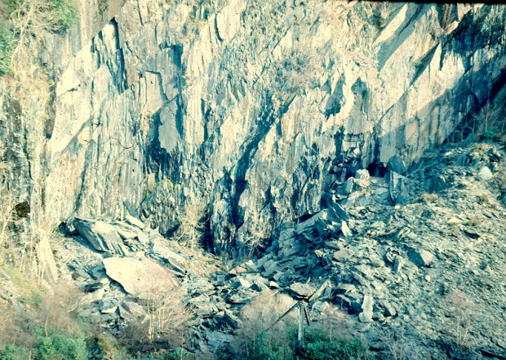
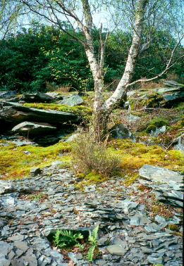
A WILD, DERELICT SITE
Notes:
The site is a slate quarry that operated from the mid-19th century until 1951. Picture at left shows a view into the huge hole that still exists at one end of the site.
The waste material from quarrying was dumped to create an artificial plateau extending into the main valley, of about 5 acres, 100 foot high at its edge. Most of our developments have been on this plateau.
Between 1951 and the beginnings of CAT in 1974 there was extensive recolonisation by (mostly) wild plants. The rather distinctive succession process can be seen in the photo at right, with lichens, mosses and ferns creating a thin fertile layer in which tree seedlings can germinate and become established. Here you can see the the nitrogen-fixing Calluna vulgaris, the pioneer tree species Betula pubescens, and at rear the raucous re-invader (native here 2m years ago before the ice-age cycle) Rhododendron ponticum.

Slide 6
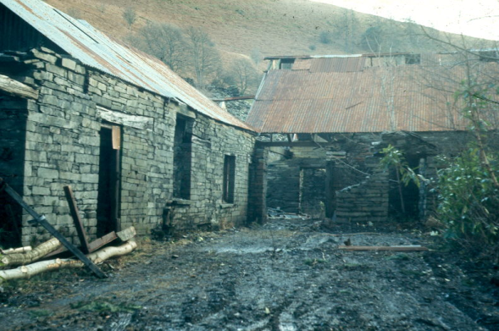
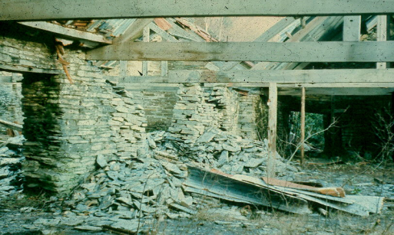
WITH RUINED BUILDINGS
Notes:
Many of the original slate-working buildings had sound walls, and a few even had roofs. The one on the left was the shed where the small railway engines used to pull the slate wagons had been stored. It became the temporary kitchen, store-room, dining room, workshop, reception parlour, concert-hall and debating chamber. It was later rebuilt as the Restaurant and lecture-room, with dormitory accommodation above.
At right are the remains of the slate cutting sheds. The sound roof trusses were retained and the building became the main office and exhibition space.

Slide 7
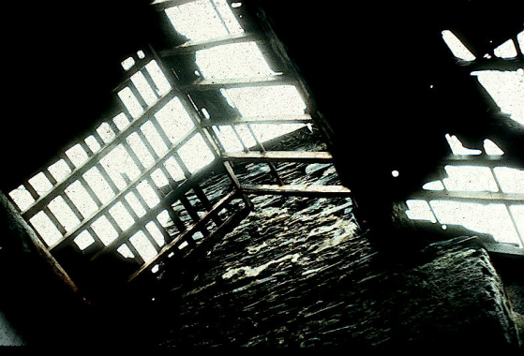
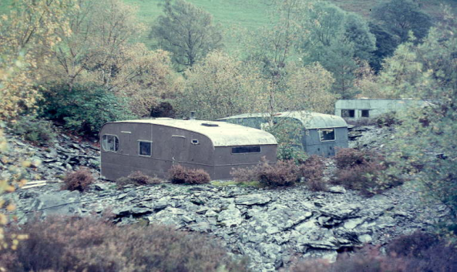
AND DIFFICULT CONDITIONS CONDITIONS
Notes:
In February 1974 there were no buildings remotely fit to live in. There were old cottages, but they all had roofs like that shown on the left. Most staff opted for static caravans, but a few covered the old roofs with tarpaulins and camped in the the buildings until repairs were complete.
The weather was (and is) usually awful.
There was very little money.

Slide 8
AT THIS TIME MOST OF THE STAFF LIVED ON THE SITE…
...AND THOUGHT OF THE PROJECT AS A KIND OF ‘ECOVILLAGE’

Slide 9
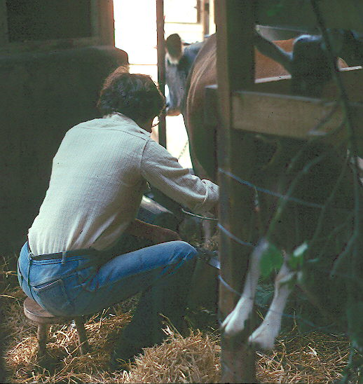
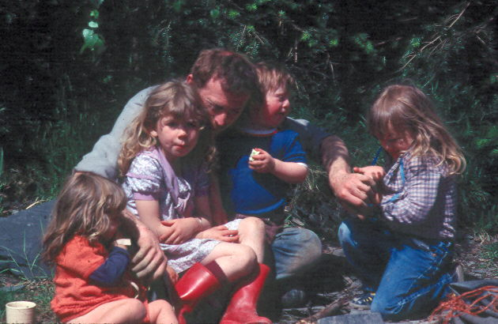
FOR SOME, IT WAS A RURAL IDYLL
Notes:
Milking a Jersey cow was one of the principal touchstones for having made it to Utopia. Perhaps it still is.
The person at right surrounded by children is Roger MacLennan, who still works the gardens a whole generation later. Roger and his wife Christine brought up four kids on the site. Daughter Laura in his lap is now a theatre professional and has been responsible for setting up the summer children’s thaatre programmes. She reappears as a grown-up later in this slide show.

Slide 10
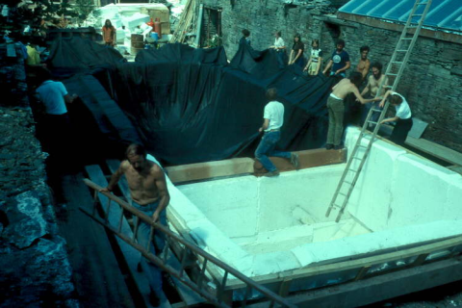
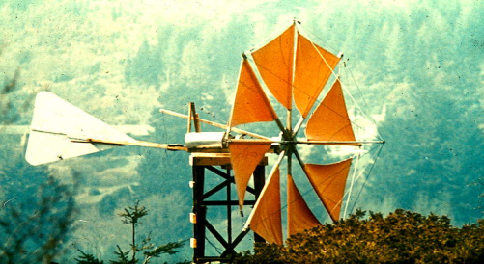
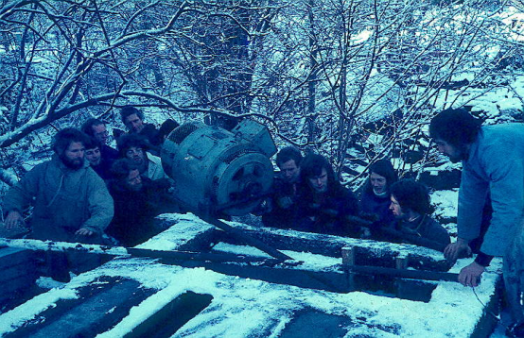
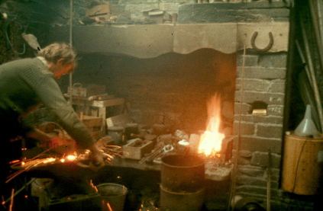
FOR OTHERS, A PERIOD OF HEROIC TECHNOLOGY...
Notes:
The seventies was period when anything seemed possible. From bottom left, clockwise:
Roger White established the forge, a metalworking workshop and foundry. Although now with an independent business in Scotland, he still returns every year to re-commission the Cliff Railway and run the very popular blacksmithing courses.
Putting the liner into a 100 cubic metre insulated tank to provide interseasonal solar heat storage. A very ambitious project for 1977.
‘Cretan’ style wind generator using cloth sails and car parts for the dynamo and yawing mechanism. The striking shapes became an important icon for the young organisation. The Cretan nicely sums up the funky low-tech approach favoured in those days.
The alternator for the first hydro-system being installed on a cold and frosty morning. This is 1977 I think

Slide 11
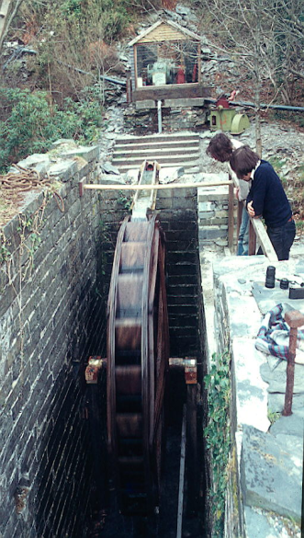
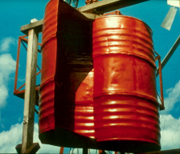
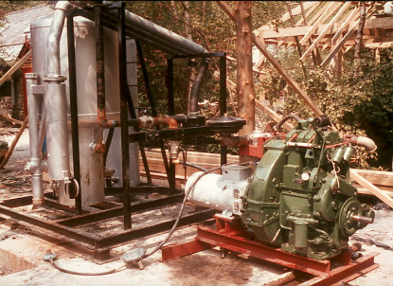
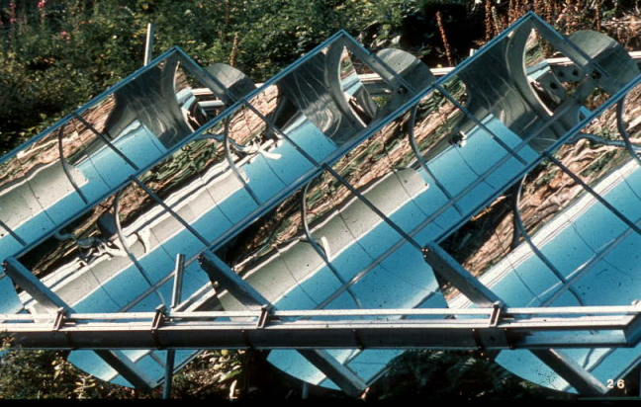
...LOTS OF IT
Notes:
It went on into the eighties. Clockwise from left:
The pelton turbine that was being installed in the last slide can be seen at the back, in a glass-walled shed. It generated about 1.5kW and was the backbone of the on-site electricity system for many years. Meanwhile the original water-wheel pit built in the 19th century had been cleaned out and by way of demonstration a model overshot wheel was built out of wood. This was never intended to generate any useful power, but its size and rustic charm persuaded most visitors that it was highly effective.
The vertical axis ‘Savonius Rotor’ made of a split oil drum was another icon of the seventies, de rgueur for any self-respecting alternative community. Like the water wheel, it never did anything useful.
A retort designed to generate gas from wood-chips, with the air-cooled engine and generator for turning wood-gas into electricity. Great idea but of low efficiency and a lot of hard work on this scale, so soon abandoned by busy engineers.
Array of sun-tracking, concentrating mirrors, with heat-resistant glass tubes at the focus. Water was fed along the tubes to generate steam which was run to small steam- engine running a dynamo. Needing direct sunlight, it rarely performed in the cloudy climate of mid-Wales, and when it did was calculated to operate at an efficiency of about 0.5%. Still, it looked terrific.

Slide 12
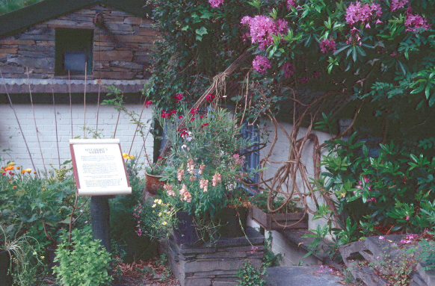
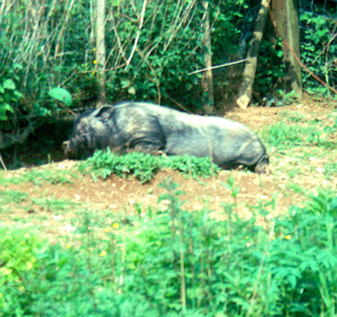
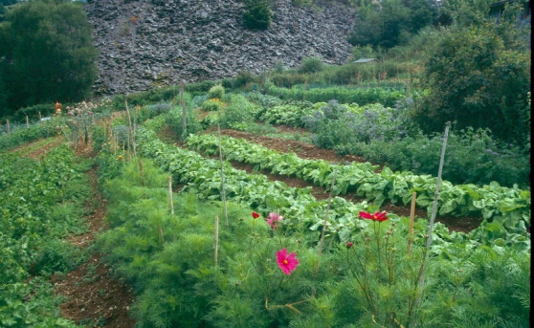
BUT THERE WERE ALSO GARDENS AND ANIMALS
…and organic vegetables

Slide 13
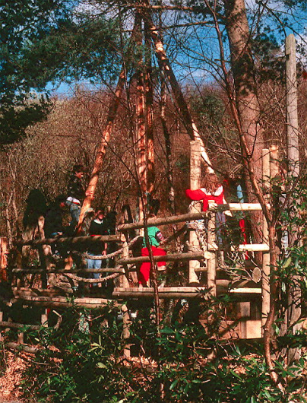
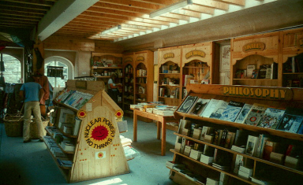
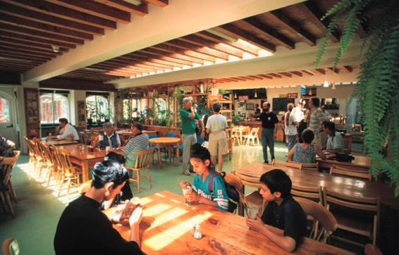
AND FACILITIES FOR VISITORS
Notes:
The engine-shed building was rebuilt and housed the restaurant (bottom left) and the bookshop (centre). These were both operational by 1980. In 1985 an adventure playground was constructed from on-site timber and ropes found on the seashore. These three items, plus car-park and toilets, are the cornerstone of any successful tourist attraction

Slide 14
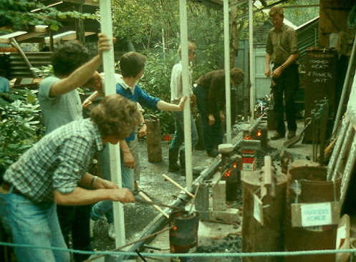
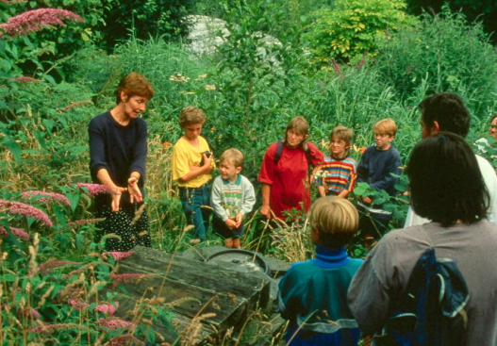
AND COURSES FOR SCHOOLS AND THE PUBLIC
Notes:
We started running courses for the general public in the late seventies. At left you see Roger White teaching the elements of metal-bashing. By 1982 we had two full-time education officers and started programmes for visiting schools.

Slide 15
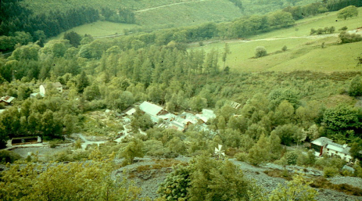
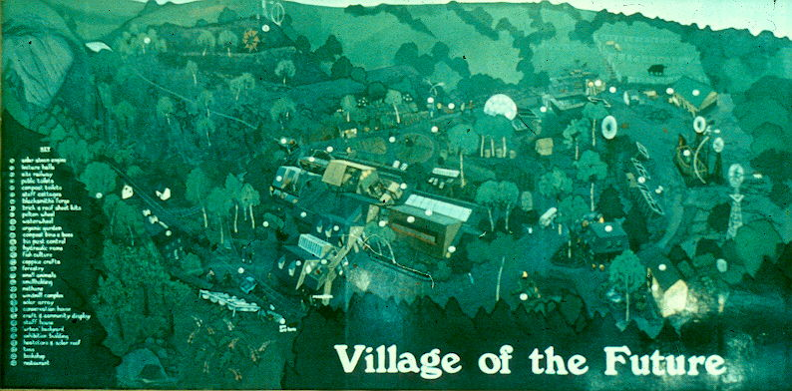
BY THE EARLY 80s IT WAS LIKE A LITTLE VILLAGE
Notes:
The bill-board size painting greeted visitors on their arrival. The inset photo shows the appearance of the site from above in 1982.

Slide 16
DURING THE 80s THERE WAS A BIG CHANGE
An ambitious development programme was initiated
Money was raised by issuing shares
CAT became more of a working community than an eco-village
There was more emphasis on education at all levels
It became more professional
But it remained a friendly and democratic place to work and to visit

Slide 17
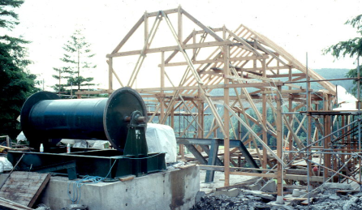
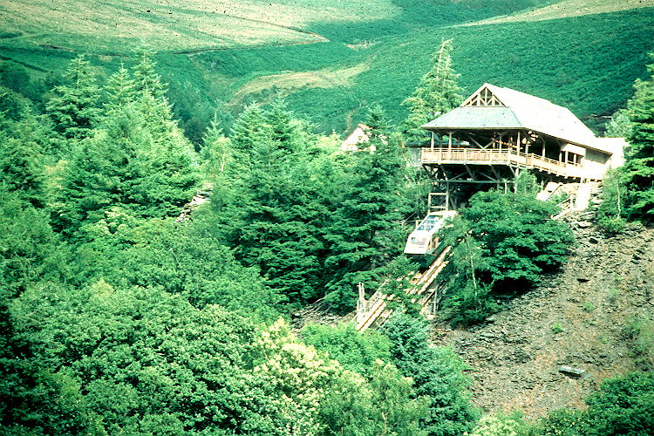
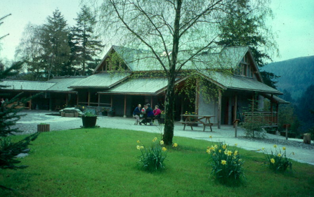
THE CHANGES WERE SYMBOLISED BY THE SPECTACULAR WATER-BALANCED CLIF RAILWAY
Notes:
At top left you see the framework of the ‘upper station’ and the winding drum that connects two railway cars. At lower left is the appearance of the finished complex which included offices, lecture hall and sales points for snacks and drinks. At right the upper station is seen from the car-park side, on top of the ‘plateau’ of slate waste. We designed and built almost everything ourselves.

Slide 18
LEGAL STRUCTURE
Daughter companies
PERMANENT STAFF
Resident community
Shareholders
Trustees
CAT plc
CAT Charity Ltd
SERVICES
Admin
Engineering
Biology
Media
Fundraising
Web site
Visitor Centre
Trading activities
Publications
Consultancy
Education
Information
Research
Members’ club

Slide 19
ORGANISATIONAL STRUCTURE (IN 2002)
PERMANENT STAFF MEETING (monthly)
Elected management committee (4)
+ Finance Director & Admin Director ex officio (weekly)
20 Departments
43 Full members
28 Associate Members
10-40 Casual staff
Wages are equal within each grade.
Maximum differential is 1.5:1

Slide 20
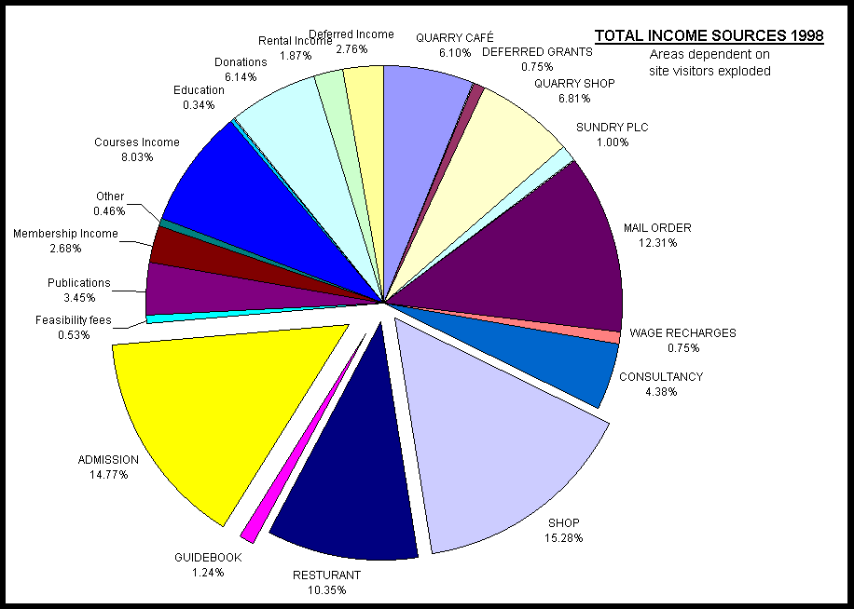
MONEY
Notes:
This pie-chart shows the large variety of income-streams that support the enterprise. Those that derive directly from tourism are exploded and are still the largest sectors. However these sectors are in relative decline and diversification continues

Slide 21
WHAT MAKES CAT SPECIAL?
Public service ethos
Slow organic growth
Careful accumulation of experience
High level of synergy between different activities
Flat wage structure
Economic self-reliance

